Slide 1
CE103 Algorithms and Programming I
Development Environments and Algorithm Basics Author: Asst. Prof. Dr. Uğur CORUH

Slide 2
CE103 Algorithms and Programming I
Week-2
Fall Semester, 2021-2022
Download DOC, SLIDE, PPTX

Slide 3
Algorithm Basics

Slide 4
Flowgorithm (1)
http://www.flowgorithm.org/
Flowgorithm - Documentation
https://github.com/timoteoponce/flowgorithm-examples

Slide 5
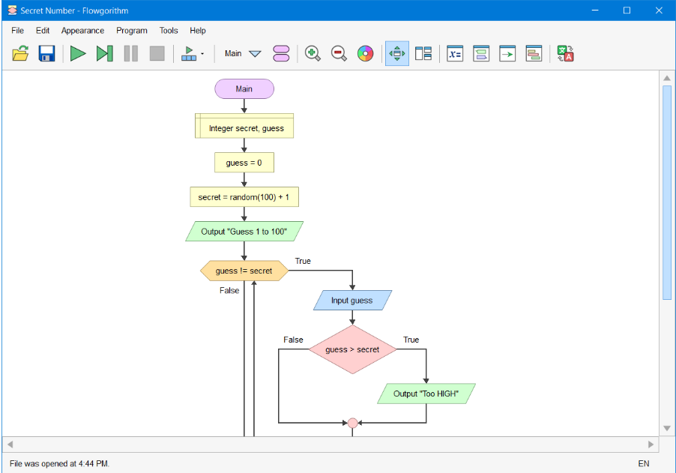
Flowgorithm (2)
Main Window
center h:500px

Slide 6
Flowgorithm (3)
Console Window
The classic method to interact with the computer is to use the “Console”. Flowgorithm attempts to make it look like a typical instant messenger window. The “chat bubbles” are color coded to match the Input and Output shapes used in the flowchart. If you don’t want to use the chat bubbles, you can also toggle between them and the classical plain text.

Slide 7
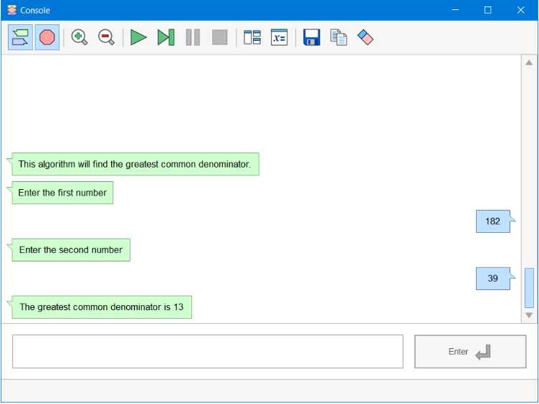
Flowgorithm (4)
Console Window
center h:450px

Slide 8
Flowgorithm (5)
Source Code Viewer Window
The Source Code Viewer can convert your flowchart to several major programming languages. So, if you planning to learn a high-level language, then this feature should help you along the way.

Slide 9
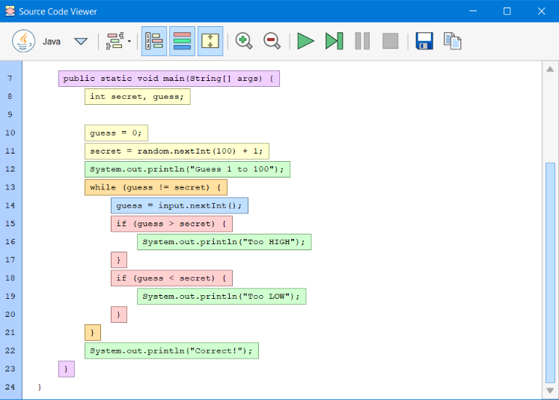
Flowgorithm (6)
Source Code Viewer Window
center h:450px

Slide 10
Flowgorithm (7)
Variable Watch Window
The variable watch window is used to keep track of how your variables are changing as your program executes. Each variable is color-coded based on its data type. At a glance, you can tell exactly what type of data is being stored - and catch where you may want to use a different data type.

Slide 11
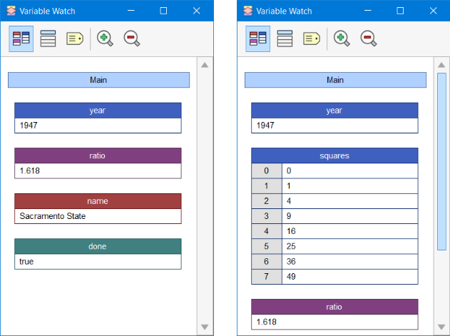
Flowgorithm (8)
Variable Watch Window
center h:450px

Slide 12
Flowgorithm (8)
More Resources for Flowgorithm
Flowgorithm Tutorial - TestingDocs.com

Slide 13
Pseudocode (1)
Algorithm design language
Pseudocode - Wikipedia
Pseudocode Examples
How to write a Pseudo Code? - GeeksforGeeks

Slide 14
Introduction to Analysis of Algorithms
In this course, we will learn how to code with several development environments and next term we will see an analysis of algorithms in detail.
This topic is covered in the following link:
CE100 Introduction to Analysis of Algorithms

Slide 15
Programming Environment Setup and Configuration
Programming life is not about only learning how to code. Mostly you need to use several code development environments and you need to learn how to use them efficiently.

Slide 16
C / C++ Environment and Development

Slide 17
DevCpp (Install / Compile / Run / Debug) (1)
Download DevC++ IDE from the following link
https://www.bloodshed.net/

Slide 18
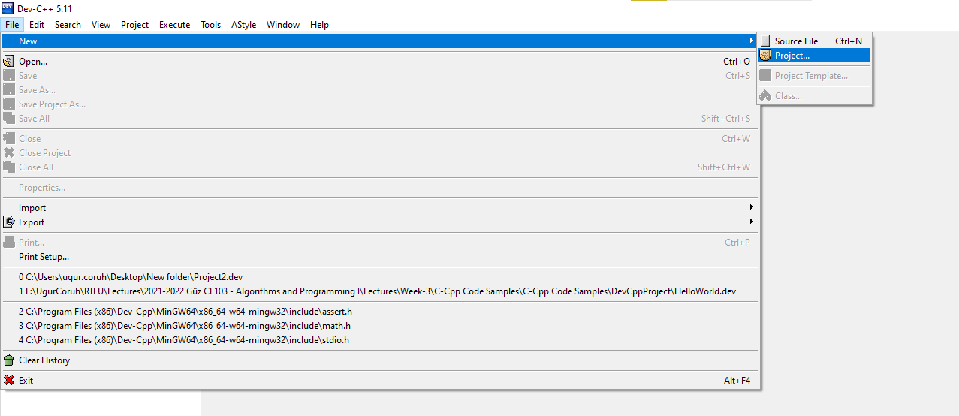
DevCpp (Install / Compile / Run / Debug) (2)
Open DevC++ IDE for C Project Generation Open File->New->Project
alt:“alt” height:400px center

Slide 19
DevCpp (Install / Compile / Run / Debug) (3)
Select Console Application from Basic tab and with C Project Option and write a project name such as “Hello” then press OK
Select a folder and save Hello.dev project file.

Slide 20
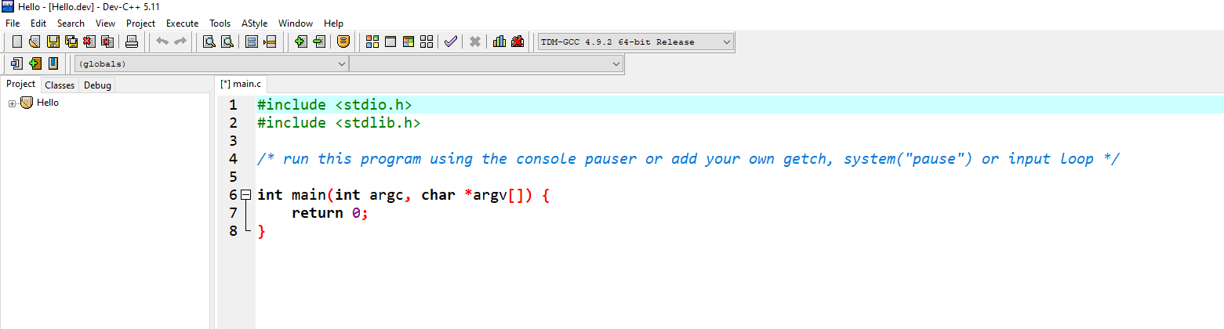
DevCpp (Install / Compile / Run / Debug) (4)
You will see a sample main with an empty body
alt:“alt” height:300px center

Slide 21
DevCpp (Install / Compile / Run / Debug) (5)
#include <stdio.h> #include <stdlib.h> /* run this program using the console pauser or add your own getch, s,ystem("pause") or input loop */ int main(int argc, char *argv[]) { retAdd 0; }

Slide 22
DevCpp (Install / Compile / Run / Debug) (6)
Add the following line in the main function. This will write “Hello, World!” on the screen and then wait for a keypress to exit from the application
#include <stdio.h> #include <stdlib.h> /* run this program using the console pauser or add your own getch, system("pause") or input loop */ int main(int argc, char *argv[]) { printf("Hello, World!"); getchar(); return 0; }

Slide 23
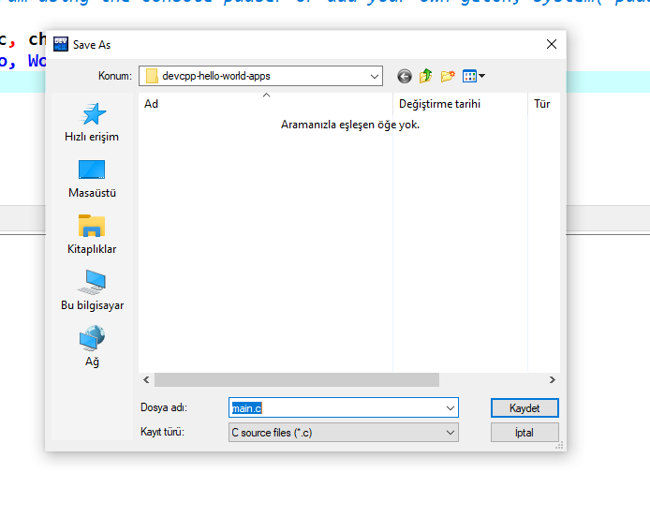
DevCpp (Install / Compile / Run / Debug) (7)
Then save the file
alt:“alt” height:450px center

Slide 24
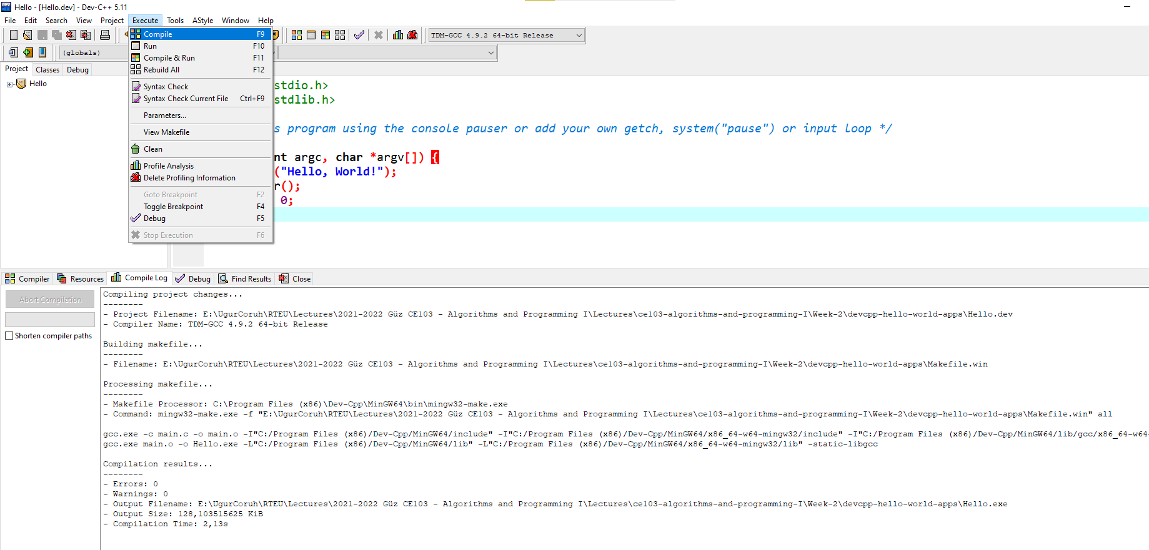
DevCpp (Install / Compile / Run / Debug) (8)
Use from menu Execute->Compile F5 to generate Hello.exe
alt:“alt” height:450px center

Slide 25
DevCpp (Install / Compile / Run / Debug) (9)
You can find the generated Hello.exe path from Compile.log as follow. Check the Output Filename
Compiling project changes... -------- - Project Filename: E:\UgurCoruh\RTEU\Lectures\2021-2022 Güz CE103 - Algorithms and Programming I\Lectures\ce103-algorithms-and-programming-I\Week-2\devcpp-hello-world-apps\Hello.dev - Compiler Name: TDM-GCC 4.9.2 64-bit Release Building makefile... -------- - Filename: E:\UgurCoruh\RTEU\Lectures\2021-2022 Güz CE103 - Algorithms and Programming I\Lectures\ce103-algorithms-and-programming-I\Week-2\devcpp-hello-world-apps\Makefile.win Processing makefile... -------- - Makefile Processor: C:\Program Files (x86)\Dev-Cpp\MinGW64\bin\mingw32-make.exe - Command: mingw32-make.exe -f "E:\UgurCoruh\RTEU\Lectures\2021-2022 Güz CE103 - Algorithms and Programming I\Lectures\ce103-algorithms-and-programming-I\Week-2\devcpp-hello-world-apps\Makefile.win" all gcc.exe -c main.c -o main.o -I"C:/Program Files (x86)/Dev-Cpp/MinGW64/include" -I"C:/Program Files (x86)/Dev-Cpp/MinGW64/x86_64-w64-mingw32/include" -I"C:/Program Files (x86)/Dev-Cpp/MinGW64/lib/gcc/x86_64-w64-mingw32/4.9.2/include" gcc.exe main.o -o Hello.exe -L"C:/Program Files (x86)/Dev-Cpp/MinGW64/lib" -L"C:/Program Files (x86)/Dev-Cpp/MinGW64/x86_64-w64-mingw32/lib" -static-libgcc Compilation results... -------- - Errors: 0 - Warnings: 0 - Output Filename: E:\UgurCoruh\RTEU\Lectures\2021-2022 Güz CE103 - Algorithms and Programming I\Lectures\ce103-algorithms-and-programming-I\Week-2\devcpp-hello-world-apps\Hello.exe - Output Size: 128,103515625 KiB - Compilation Time: 2,13s

Slide 26
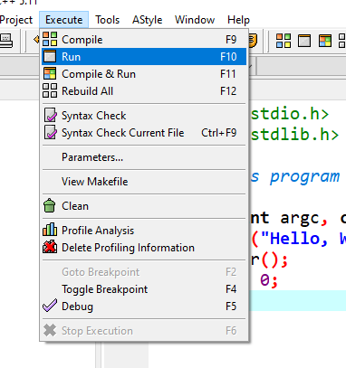
DevCpp (Install / Compile / Run / Debug) (10)
Then you can run with Execute->Run F10 or Directly Compile&Run F11
alt:“alt” height:450px center

Slide 27
DevCpp (Install / Compile / Run / Debug) (11)
for debugging operations, just change the code and add more statements as follow
#include <stdio.h> #include <stdlib.h> /* run this program using the console pauser or add your getch, system(",pause") or input loop */ int main(int argc, char *argv[]) { printf("Hello, World! Step-1\n"); printf("Hello, World! Step-2\n"); printf("Hello, World! Step-3\n"); printf("Hello, World! Step-4\n"); printf("Hello, World! Step-5\n"); printf("Hello, World! Step-6\n"); getchar(); return 0; }

Slide 28
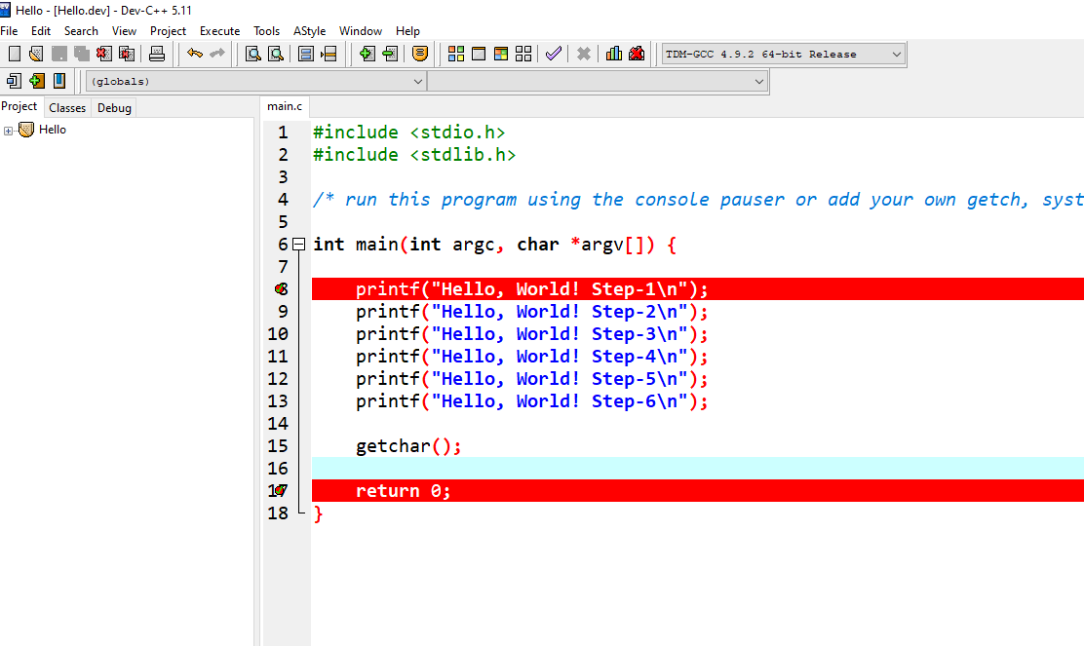
DevCpp (Install / Compile / Run / Debug) (12)
Click on line numbers and add breakpoints for the debugger. This red point will be debugger stop points
alt:“alt” height:450px center

Slide 29
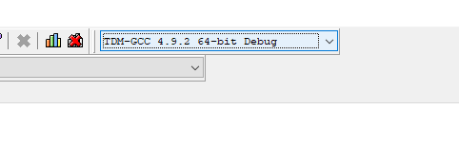
DevCpp (Install / Compile / Run / Debug) (13)
In the menu section, select the compiler with debug option
alt:“alt” height:250px center

Slide 30
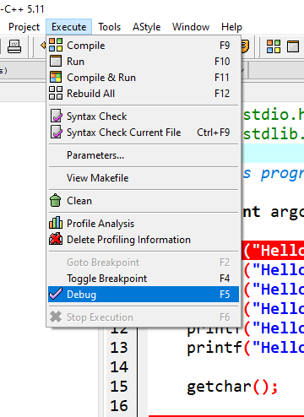
DevCpp (Install / Compile / Run / Debug) (14)
Compile application with debugging setting and in Execute Section use Debug F5 to start debugging
alt:“alt” height:450px center

Slide 31
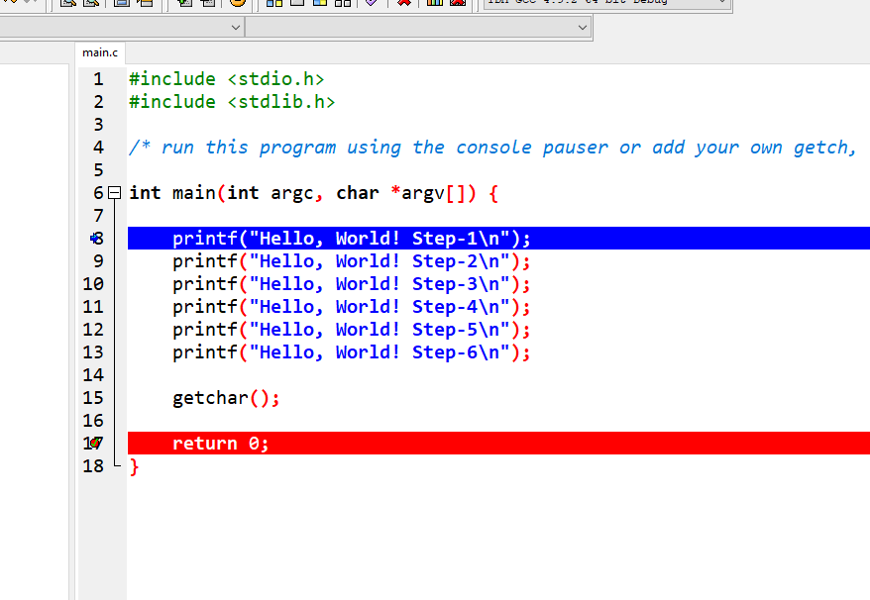
DevCpp (Install / Compile / Run / Debug) (15)
The debugger will stop at the breakpoint at the debug point (blue line)
alt:“alt” height:450px center

Slide 32
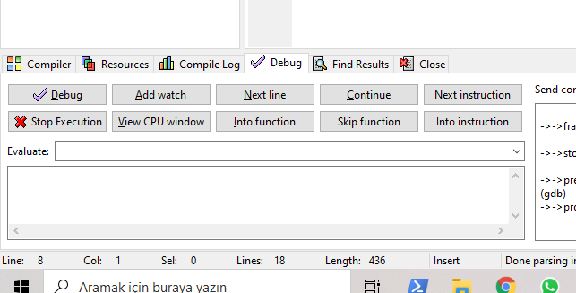
DevCpp (Install / Compile / Run / Debug) (16)
Moving to the next statement can be done via control buttons or shortcuts
alt:“alt” height:450px center

Slide 33
DevCpp (Install / Compile / Run / Debug) (17)
-Press F8to step-by-step continue
Then go to Project Options -> Compiler -> Linker and set Generate debugging information to “yes”, and make sure you are not using any optimization options (they’re not good for debug mode). Also, check the Parameters tab, and make sure you don’t have any optimization options (like -O2 or -O3, but -O0 is ok because it means no optimization) or strip option (-s).

Slide 34
DevCpp (Install / Compile / Run / Debug) (18)
After that, do a full rebuild (Ctrl-F11), then set a breakpoint(s) where you want the debugger to stop (otherwise it will just run the program). To set a breakpoint on a line, just click on the gutter (the gray band on the left), or press Ctrl-F5.

Slide 35
DevCpp (Install / Compile / Run / Debug) (19)
Now you are ready to launch the debugger, by pressing F8 or clicking the debug button. If everything goes well, the program will start, and then stop at the first breakpoint. Then you can step through the code, entering function calls, by pressing Shift-F7 or the “step into” button, or stepping over the function calls, by pressing F7 or the “next step” button. You can press Ctrl-F7 or the “continue” button to continue execution till the next breakpoint. At any time, you can add or remove breakpoints.

Slide 36
DevCpp (Install / Compile / Run / Debug) (20)
When the program stopped at a breakpoint and you are stepping through the code, you can display the values of various variables in your program by putting your mouse over them, or you can display variables and expressions by pressing F4or the “add watch” button and typing the expression.

Slide 37
DevCpp (Install / Compile / Run / Debug) (21)
How do I debug using Dev-C++

Slide 38
Code Blocks (Install / Compile / Run / Debug) (1)
Download Code Blocks from the following link
Binary releases - Code::Blocks

Slide 39
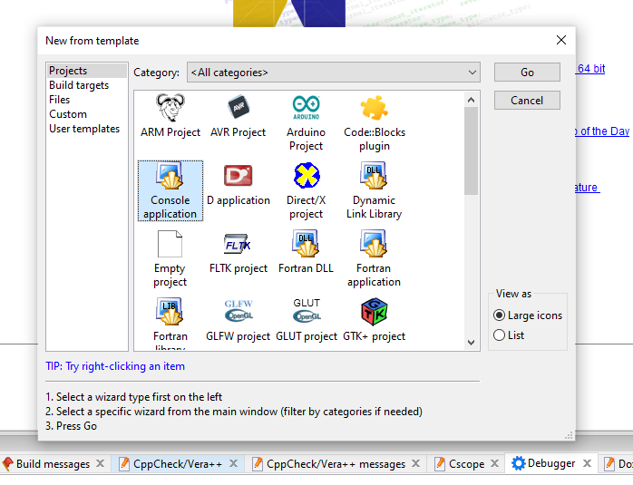
Code Blocks (Install / Compile / Run / Debug) (2)
Open Code Blocks and
Select File->New->Project
alt:“alt” height:450px center

Slide 40
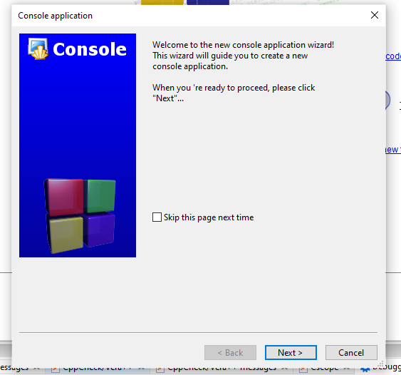
Code Blocks (Install / Compile / Run / Debug) (3)
Select Console Application
Click Next from Opening Window
alt:“alt” height:450px center

Slide 41
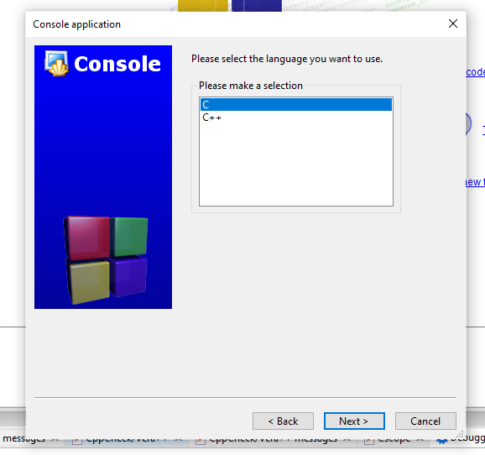
Code Blocks (Install / Compile / Run / Debug) (4)
Select C for Sample Project
alt:“alt” height:450px center

Slide 42
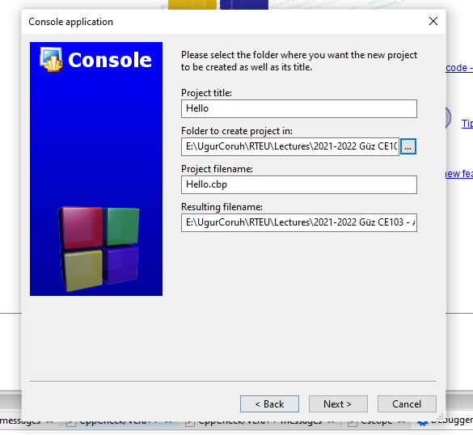
Code Blocks (Install / Compile / Run / Debug) (5)
Write a project name and title also set a project folder
alt:“alt” height:450px center

Slide 43
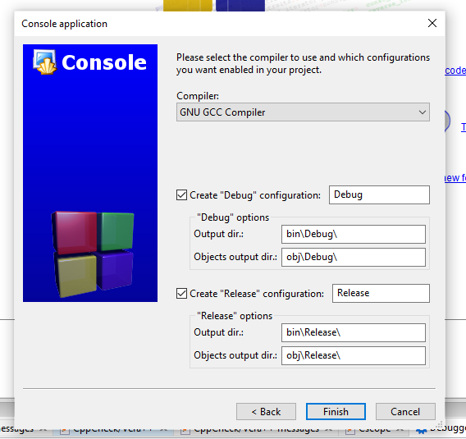
Code Blocks (Install / Compile / Run / Debug) (6)
Select a compiler for this project we selected GCC but you can select C compilers from the list. Set Debug and Release executable output folders.
alt:“alt” height:450px center

Slide 44
Code Blocks (Install / Compile / Run / Debug) (7)
After this wizard, you will have the following code
#include <stdio.h> #include <stdlib.h> int main() { printf("Hello world!\n"); return 0; }

Slide 45
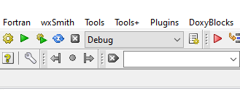
Code Blocks (Install / Compile / Run / Debug) (8)
Select Debug Build from the menu
alt:“alt” height:300px center

Slide 46
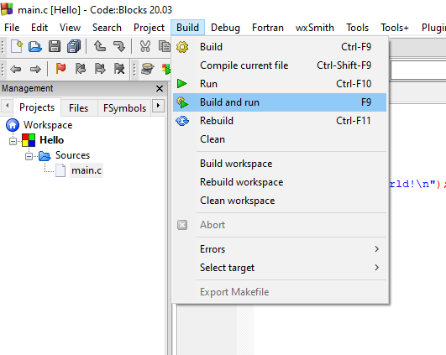
Code Blocks (Install / Compile / Run / Debug) (9)
Run with Build and Run F9
alt:“alt” height:450px center

Slide 47
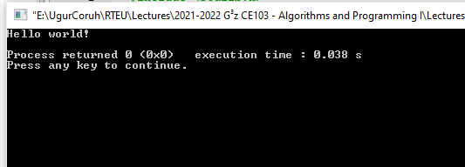
Code Blocks (Install / Compile / Run / Debug) (10)
You should see the following output
alt:“alt” height:450px center

Slide 48
Code Blocks (Install / Compile / Run / Debug) (11)
Add the following lines to your source code for debugging
#include <stdio.h> #include <stdlib.h> int main() { printf("Hello world! Step-1\n"); printf("Hello world! Step-2\n"); printf("Hello world! Step-3\n"); printf("Hello world! Step-4\n"); printf("Hello world! Step-5\n"); printf("Hello world! Step-6\n"); return 0; }

Slide 49
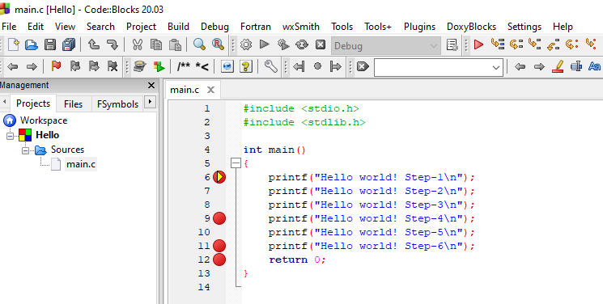
Code Blocks (Install / Compile / Run / Debug) (12)
and add breakpoints with F5 or mouse click
alt:“alt” height:450px center

Slide 50
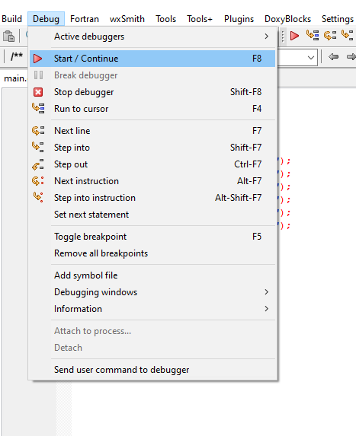
Code Blocks (Install / Compile / Run / Debug) (13)
select Debug->Start/Continue to start debugger
alt:“alt” height:450px center

Slide 51
Code Blocks (Install / Compile / Run / Debug) (14)
If you see the following error this is related to long or turkish characters including the path. Just move the project to a shorter path and try again
Setting breakpoints Debugger name and version: GNU gdb (GDB) 8.1 Starting the debuggee failed: No executable specified, use `target exec'. Debugger finished with status 0

Slide 52
Code Blocks (Install / Compile / Run / Debug) (15)
You will see the following yellow pointer for the debugger
alt:“alt” height:450px center

Slide 53
Code Blocks (Install / Compile / Run / Debug) (16)
You can use the following menu or shortcuts for step-by-step debugging.
alt:“alt” height:150px center

Slide 54
GCC/G++ Complier (MinGW) / Clang-cl (LLVM) (1)
Download and install MinGW or LLVM compiler (if you downloaded then skip this step)
MinGW installer (clang)
Download MinGW-w64 - for 32 and 64-bit Windows from SourceForge.net
If you have a problem try `Github`` builds
https://github.com/niXman/mingw-builds-binaries/releases
https://github.com/niXman/mingw-builds-binaries/releases/download/12.2.0-rt_v10-rev0/x86_64-12.2.0-release-win32-seh-rt_v10-rev0.7z
LLVM installer (gcc/g++)
Download LLVM releases
Also use the following notes
https://llvm.org/devmtg/2014-04/PDFs/Talks/clang-cl.pdf

Slide 55
GCC/G++ Complier (MinGW) / Clang-cl (LLVM) (2)
Open a console with “cmd” and test the following commands if commands are not recognized then set the system environment variable to add gcc and g++ executable paths to the path variable (add to both system and user path variable)
gcc --version g++ --version
C:\Users\ugur.coruh>gcc --version gcc (x86_64-win32-seh-rev0, Built by MinGW-W64 project) 8.1.0 Copyright (C) 2018 Free Software Foundation, Inc. This is free software; see the source for copying conditions. There is NO warranty; not even for MERCHANTABILITY or FITNESS FOR A PARTICULAR PURPOSE.
clang --version

Slide 56
GCC/G++ Complier (MinGW) / Clang-cl (LLVM) (3)
for gcc.exe, g++.exe and gdb.exe
C:\Program Files\mingw-w64\x86_64-8.1.0-win32-seh-rt_v6-rev0\mingw64\bin
for clang.exe, lldb.exe
C:\Program Files\LLVM\bin
This folder path changes according to your setup

Slide 57
VSCode (Install / Compile / Run / Debug) (1)
Download Visual Studio Code from the following link
Download Visual Studio Code - Mac, Linux, Windows

Slide 58
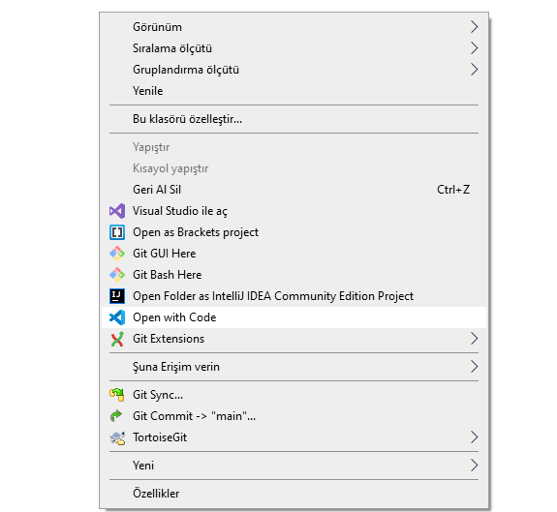
VSCode (Install / Compile / Run / Debug) (2)
In this sample, you will find MinGW and LLVM compiler combinations for C and C++
Create a folder and enter this folder then open this folder with vscode by right click
alt:“alt” height:350px center

Slide 59
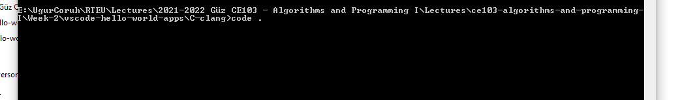
VSCode (Install / Compile / Run / Debug) (3)
or enter the folder via console
alt:“alt” height:200px center

Slide 60
write
code .

Slide 61
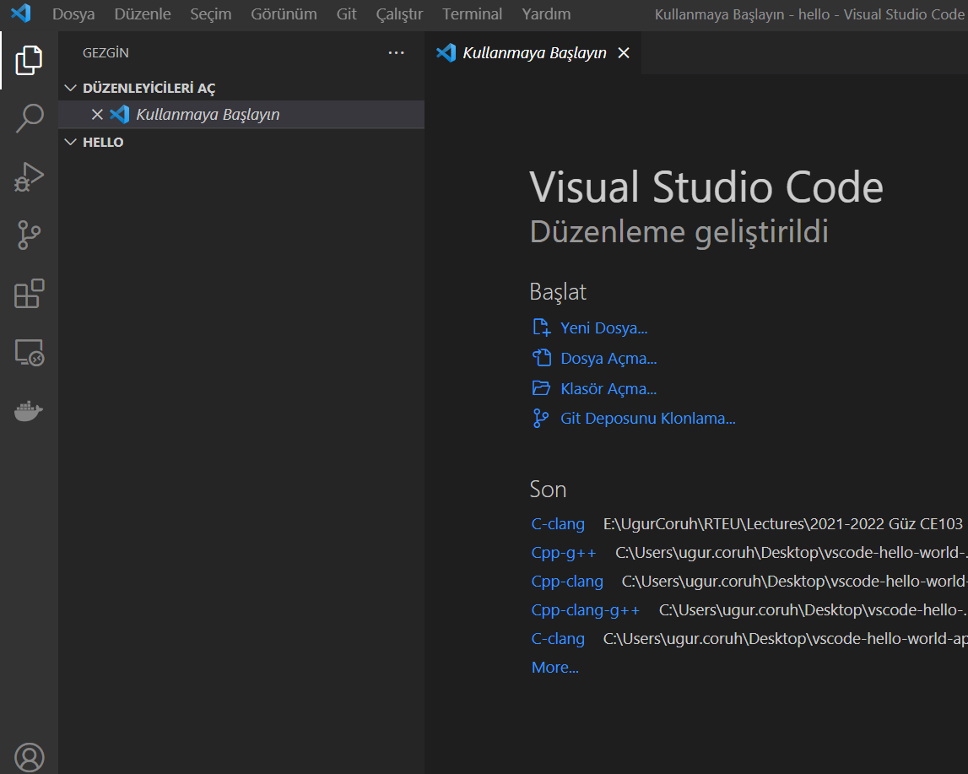
VSCode (Install / Compile / Run / Debug) (4)
This will open vscode for the current folder, (.) dot present current folder.
You will see an empty folder in the right window
alt:“alt” height:450px center

Slide 62
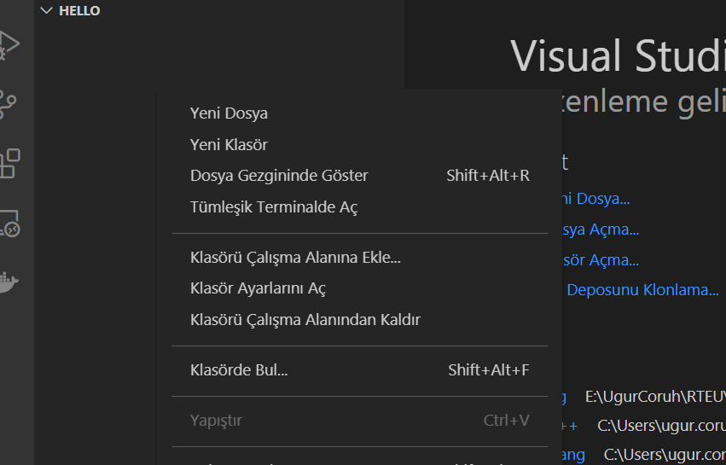
VSCode (Install / Compile / Run / Debug) (5)
alt:“alt” height:450px center

Slide 63
VSCode (Install / Compile / Run / Debug) (6)
Create a hello.c file and write the following content
#include <stdio.h> int main() { // printf() displays the string inside quotation printf("Hello, World!"); return 0; }

Slide 64
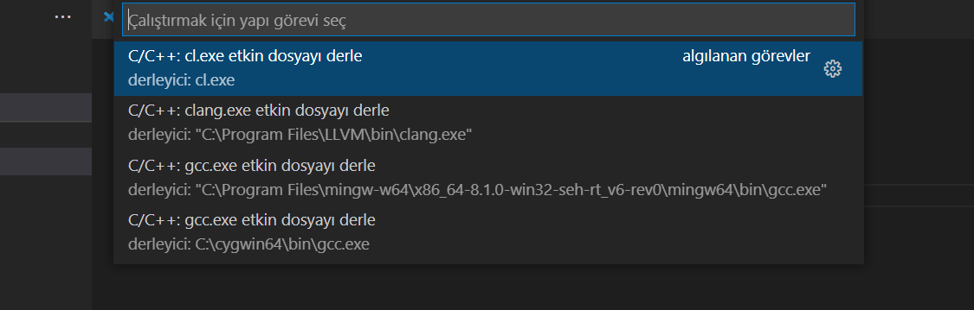
VSCode (Install / Compile / Run / Debug) (7)
use CTRL+SHIFT+B (you should be on the source code section) to build a file
alt:“alt” height:450px center

Slide 65
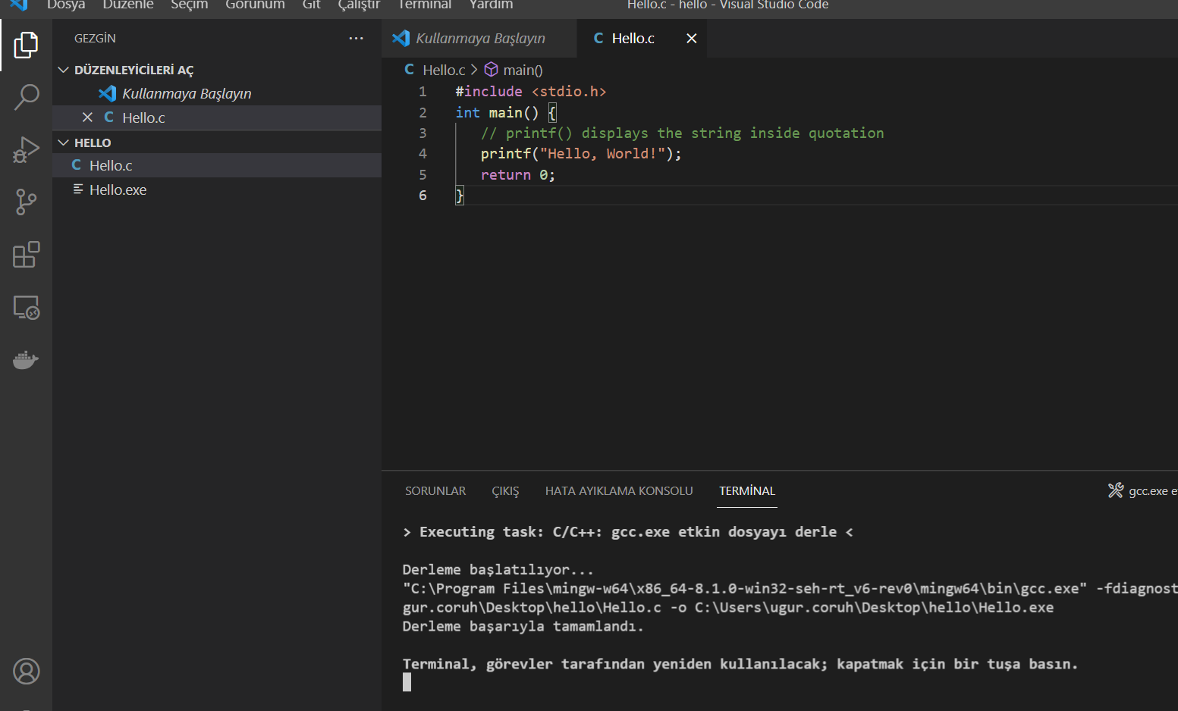
VSCode (Install / Compile / Run / Debug) (8)
Select GCCor CLANGfor this sample we can use GCC
You will see the output generated `Hello.exe``
alt:“alt” height:450px center

Slide 66
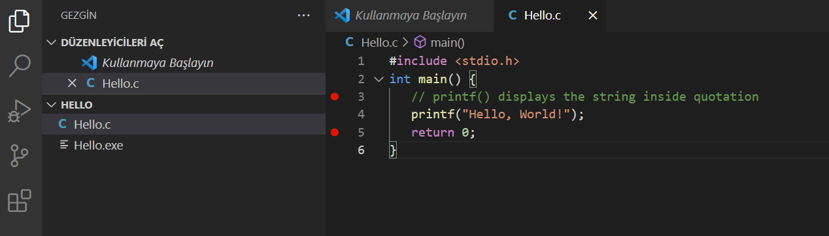
VSCode (Install / Compile / Run / Debug) (9)
for debugging just put a breakpoint and build again
alt:“alt” height:450px center

Slide 67
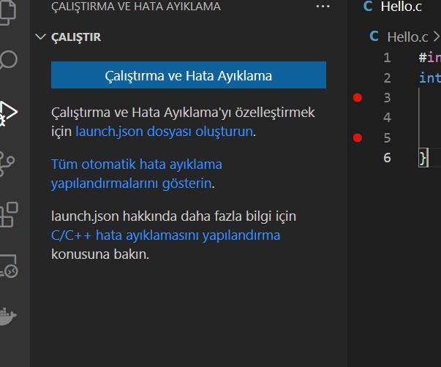
VSCode (Install / Compile / Run / Debug) (10)
after building for debug press CTRL+SHIFT+D (you should be in the source code section)and in the right window select create launch.json
alt:“alt” height:450px center

Slide 68
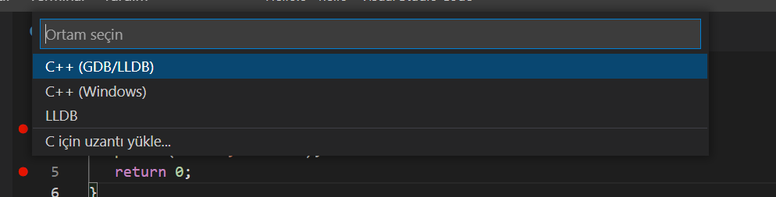
VSCode (Install / Compile / Run / Debug) (11)
from opening, window select C++ GDB/LLDB
alt:“alt” height:400px center

Slide 69
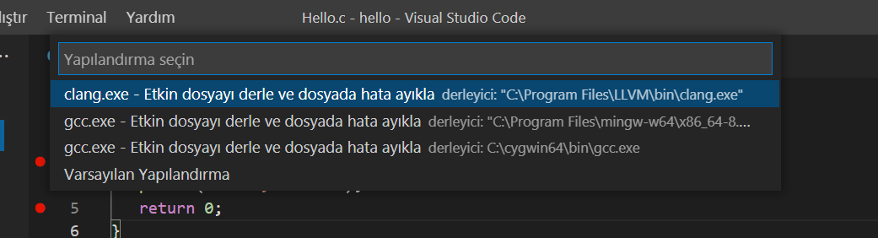
VSCode (Install / Compile / Run / Debug) (12)
from the next opening, menu select mingw-w64 gcc.exe
alt:“alt” height:400px center

Slide 70
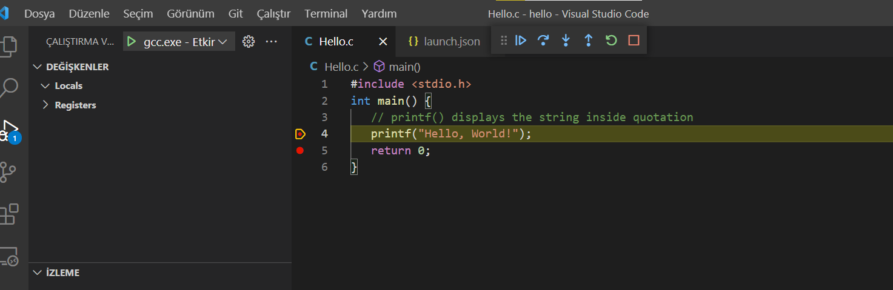
VSCode (Install / Compile / Run / Debug) (13)
this will run the debugger and you will see debug points activated
alt:“alt” height:400px center

Slide 71
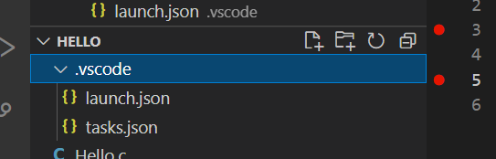
VSCode (Install / Compile / Run / Debug) (14)
then you can step-by-step debug your code.
the following task.json and launch.json automatically generated with your selections
alt:“alt” height:400px center

Slide 72
VSCode (Install / Compile / Run / Debug) (15)
launch.json
{ // Olası öznitelikler hakkında bilgi edinmek için IntelliSense kullanın. // Mevcut özniteliklerin açıklamalarını görüntülemek için üzerine gelin. // Daha fazla bilgi için şu adresi ziyaret edin: https://go.microsoft.com/fwlink/?linkid=830387 "version": "0.2.0", "configurations": [ { "name": "gcc.exe - Etkin dosyayı derle ve dosyada hata ayıkla", "type": "cppdbg", "request": "launch", "program": "${fileDirname}\\${fileBasenameNoExtension}.exe", "args": [], "stopAtEntry": false, "cwd": "${fileDirname}", "environment": [], "externalConsole": false, "MIMode": "gdb", "miDebuggerPath": "C:\\Program Files\\mingw-w64\\x86_64-8.1.0-win32-seh-rt_v6-rev0\\mingw64\\bin\\gdb.exe", "setupCommands": [ { "description": "gdb için düzgün yazdırmayı etkinleştir", "text": "-enable-pretty-printing", "ignoreFailures": true } ], "preLaunchTask": "C/C++: gcc.exe etkin dosyayı derle" } ] }

Slide 73
VSCode (Install / Compile / Run / Debug) (16)
task.json
{ "tasks": [ { "type": "cppbuild", "label": "C/C++: gcc.exe etkin dosyayı derle", "command": "C:\\Program Files\\mingw-w64\\x86_64-8.1.0-win32-seh-rt_v6-rev0\\mingw64\\bin\\gcc.exe", "args": [ "-fdiagnostics-color=always", "-g", "${file}", "-o", "${fileDirname}\\${fileBasenameNoExtension}.exe" ], "options": { "cwd": "${fileDirname}" }, "problemMatcher": ["$gcc"], "group": { "kind": "build", "isDefault": true }, "detail": "Hata Ayıklayıcısı tarafından oluşturulan görev." } ], "version": "2.0.0" }

Slide 74
VSCode (Install / Compile / Run / Debug) (17)
You can do the same thing for other compilers and C++ source codes. LLVM does not support debugging on vscode now.
for C++ VsCode you can check the following links
for Windows
https://code.visualstudio.com/docs/cpp/config-mingw
for Linux
https://code.visualstudio.com/docs/cpp/config-linux
for WSL
https://code.visualstudio.com/docs/cpp/config-wsl

Slide 75
VSCode (Install / Compile / Run / Debug) (18)
in the launch file if you start debugging with F5
(you can select debugger with CTRL+SHIFT+P and then write Debug and Selecting Configure Debugger Option)

Slide 76
VSCode (Install / Compile / Run / Debug) (19)
the following line will be your debugging application path
if you start debugging with F5in Hello.c file this will set <Hello.c base path>/Hello.exe

Slide 77
VSCode (Install / Compile / Run / Debug) (20)
You should set this correct for both LLVMand GCC configuration in launch.json
"program": "${fileDirname}\\${fileBasenameNoExtension}.exe",
Also you should set your installed debugger paths
for GCC
"miDebuggerPath": "C:\\Program Files\\mingw-w64\\x86_64-8.1.0-win32-seh-rt_v6-rev0\\mingw64\\bin\\gdb.exe",
for LLVM
"miDebuggerPath": "C:\\Program Files\\LLVM\\bin\\lldb.exe",
for more details please check the sample source codes.

Slide 78
Visual Studio Code Extension List (1)
My Extension List
Listing Installed Extensions
PS C:\Users\ugur.coruh\Desktop> code --list-extensions | % { "code --install-extension $_" }
Following topic can help you
How can you export the Visual Studio Code extension list? - Stack Overflow

Slide 79
Visual Studio Code Extension List (2)
code --install-extension 2gua.rainbow-brackets code --install-extension aaron-bond.better-comments code --install-extension abusaidm.html-snippets code --install-extension ACharLuk.easy-cpp-projects code --install-extension chris-noring.node-snippets code --install-extension cschlosser.doxdocgen code --install-extension csholmq.excel-to-markdown-table code --install-extension DaChuiOpenSource.FreeMind code --install-extension dannysteenman.cloudformation-yaml-snippets code --install-extension Dart-Code.dart-code code --install-extension Dart-Code.flutter code --install-extension digized.umple code --install-extension DotJoshJohnson.xml code --install-extension DougFinke.vscode-pandoc code --install-extension dzhavat.bracket-pair-toggler code --install-extension esbenp.prettier-vscode code --install-extension formulahendry.dotnet code --install-extension franneck94.c-cpp-runner code --install-extension gcc.

Slide 80
Visual Studio Code Extension List (3)
vscode-plugin-billionbottle code --install-extension geeklearningio.graphviz-markdown-preview code --install-extension geyao.html-snippets code --install-extension GitHub.copilot-nightly code --install-extension GrapeCity.gc-excelviewer code --install-extension Ionide.Ionide-fsharp code --install-extension ionut-botizan.vscode-cypher-ql code --install-extension ipedrazas.kubernetes-snippets code --install-extension JakeWilson.vscode-picture code --install-extension James-Yu.latex-workshop code --install-extension JasonMejane.base64viewer code --install-extension jasonnutter.search-node-modules code --install-extension jebbs.plantuml code --install-extension jeff-hykin.better-cpp-syntax code --install-extension Katacoda.vscode code --install-extension KenDomino.Antlrvsix-vscode code --install-extension l7ssha.tag-inserter code --install-extension lolkush.quickstart code --install-extension marp-team.marp-vscode code --install-extension mindaro-dev.file-downloader code --install-extension mindaro.mindaro code --install-extension ms-azuretools.vscode-docker code --install-extension MS-CEINTL.vscode-language-pack-tr

Slide 81
Visual Studio Code Extension List (4)
code --install-extension ms-dotnettools.csharp code --install-extension ms-dotnettools.dotnet-interactive-vscode code --install-extension ms-dotnettools.vscode-dotnet-pack code --install-extension ms-dotnettools.vscode-dotnet-runtime code --install-extension ms-kubernetes-tools.vscode-aks-tools code --install-extension ms-kubernetes-tools.vscode-kubernetes-tools code --install-extension ms-python.python code --install-extension ms-python.vscode-pylance code --install-extension ms-toolsai.jupyter code --install-extension ms-toolsai.jupyter-keymap code --install-extension ms-toolsai.jupyter-renderers code --install-extension ms-vscode-remote.remote-containers code --install-extension ms-vscode-remote.remote-ssh code --install-extension ms-vscode-remote.remote-ssh-edit code --install-extension ms-vscode-remote.remote-wsl

Slide 82
Visual Studio Code Extension List (5)
code --install-extension ms-vscode.azure-account code --install-extension ms-vscode.brackets-keybindings code --install-extension ms-vscode.brackets-pack code --install-extension ms-vscode.cmake-tools code --install-extension ms-vscode.cpptools code --install-extension ms-vscode.cpptools-extension-pack code --install-extension ms-vscode.cpptools-themes code --install-extension ms-vscode.live-server code --install-extension ms-vsliveshare.vsliveshare code --install-extension oleg-shilo.cs-script code --install-extension PascalReitermann93.vscode-yaml-sort

Slide 83
Visual Studio Code Extension List (6)
code --install-extension Pivotal.vscode-boot-dev-pack code --install-extension Pivotal.vscode-concourse code --install-extension Pivotal.vscode-manifest-yaml code --install-extension Pivotal.vscode-spring-boot code --install-extension PKief.material-icon-theme code --install-extension platformio.platformio-ide code --install-extension pranaygp.vscode-css-peek code --install-extension redhat.fabric8-analytics code --install-extension redhat.java code --install-extension redhat.vscode-commons code --install-extension redhat.vscode-xml code --install-extension redhat.vscode-yaml code --install-extension ritwickdey.LiveServer code --install-extension sidthesloth.html5-boilerplate code --install-extension TaodongWu.ejs-snippets code --install-extension tht13.python code --install-extension tomoki1207.pdf code --install-extension twxs.cmake code --install-extension vadimcn.vscode-lldb

Slide 84
Visual Studio Code Extension List (7)
code --install-extension VisualStudioExptTeam.intellicode-api-usage-examples code --install-extension VisualStudioExptTeam.vscodeintellicode code --install-extension vscjava.vscode-java-debug code --install-extension vscjava.vscode-java-dependency code --install-extension vscjava.vscode-java-pack code --install-extension vscjava.vscode-java-test code --install-extension vscjava.vscode-maven code --install-extension vscjava.vscode-spring-boot-dashboard code --install-extension vscjava.vscode-spring-initializr code --install-extension walkme.HTML5-extension-pack code --install-extension webfreak.debug code --install-extension well-ar.plantuml code --install-extension wildboar.asn1 code --install-extension Zignd.html-css-class-completion

Slide 85
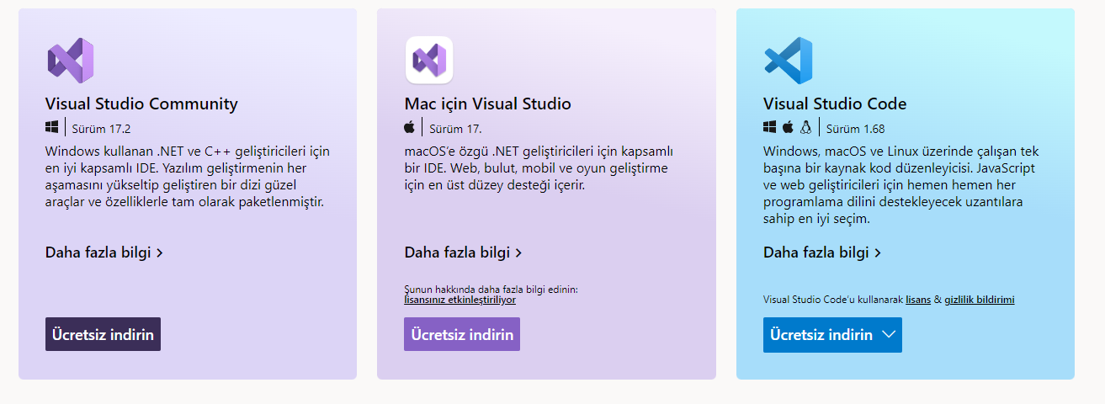
Visual Studio Community Edition (Install / Compile / Run / Debug) (1)
Download and install Visual Studio Community Edition
Select All Development Environments from Installer.
Ücretsiz Geliştirici Yazılımları ve Hizmetleri - Visual Studio
center height:400px

Slide 86
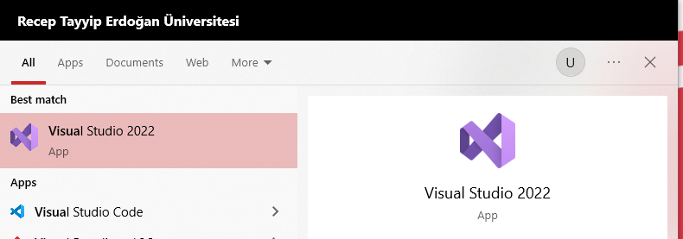
Visual Studio Community Edition (Install / Compile / Run / Debug) (2)
After installation open Visual Studio2022` from the menu.
center height:300px

Slide 87

Visual Studio Community Edition (Install / Compile / Run / Debug) (3)
The application will start…
center height:300px

Slide 88
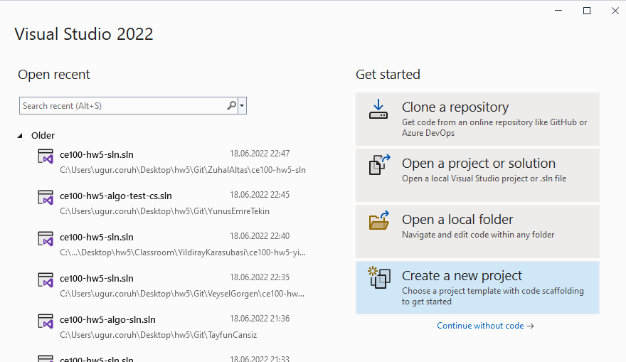
Visual Studio Community Edition (Install / Compile / Run / Debug) (4)
From Opening Window Select Create a new project
bg right height:350px

Slide 89
Visual Studio Community Edition (Install / Compile / Run / Debug) (5)
There will be several options, you can review them.
Select Windows, C++, Console Application from Combobox.
Select Console Application
bg right height:450px

Slide 90
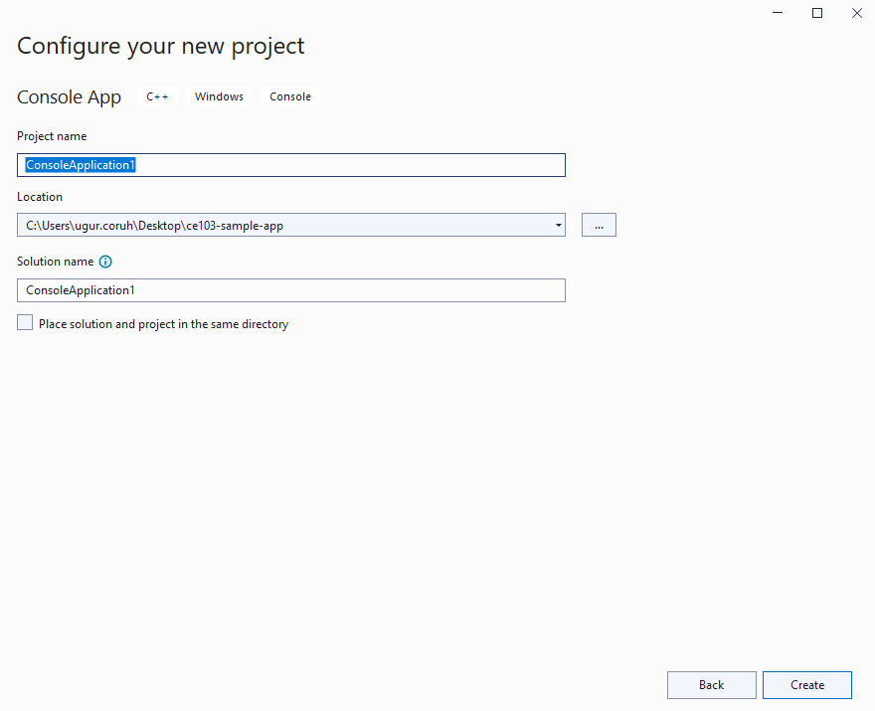
Visual Studio Community Edition (Install / Compile / Run / Debug) (6)
Give a solution and project name.
Select save location
bg right height:350px

Slide 91
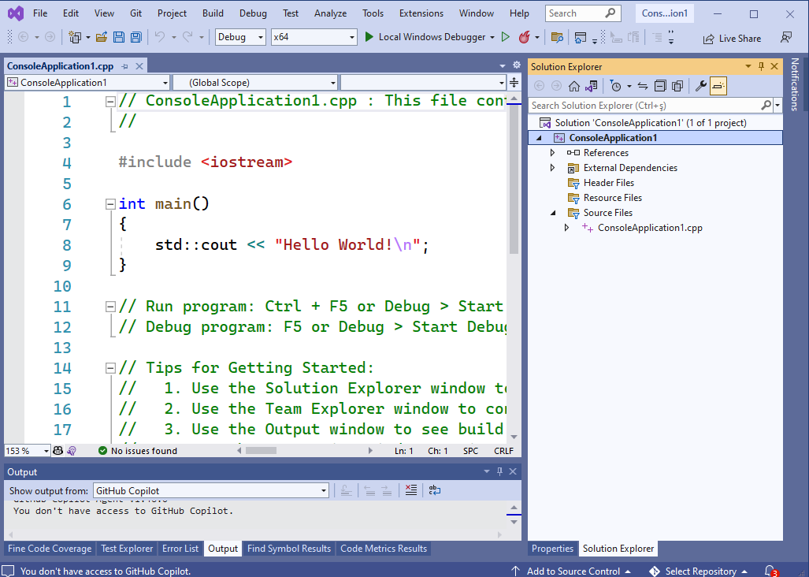
Visual Studio Community Edition (Install / Compile / Run / Debug) (7)
You will have C++ basic Hello World application.
bg right height:350px

Slide 92
Visual Studio Community Edition (Install / Compile / Run / Debug) (8)
You will have C++ basic Hello World application.
// ConsoleApplication1.cpp : This file contains the 'main' function. Program execution begins and ends there. // #include <iostream> int main() { std::cout << "Hello World!\n"; } // Run program: Ctrl + F5 or Debug > Start Without Debugging menu // Debug program: F5 or Debug > Start Debugging menu // Tips for Getting Started: // 1. Use the Solution Explorer window to add/manage files // 2. Use the Team Explorer window to connect to source control // 3. Use the Output window to see build output and other messages // 4. Use the Error List window to view errors // 5. Go to Project > Add New Item to create new code files, or Project > Add Existing Item to add existing code files to the project // 6. In the future, to open this project again, go to File > Open > Project and select the .sln file

Slide 93
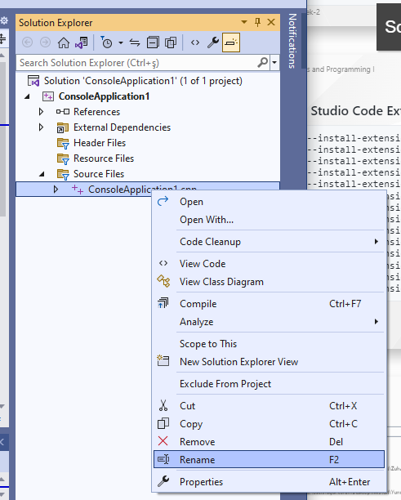
Visual Studio Community Edition (Install / Compile / Run / Debug) (9)
We need to rename the file extension to c from cpp
bg right height:350px

Slide 94
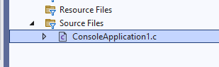
Visual Studio Community Edition (Install / Compile / Run / Debug) (10)
If you compile the source C compiler will be used.
bg right height:200px

Slide 95
Visual Studio Community Edition (Install / Compile / Run / Debug) (11)
We need to update our source for C as follows
// ConsoleApplication1.c : This file contains the 'main' function. Program execution begins and ends there. // #include <stdio.h> int main(){ printf("Hello World!\n"); }

Slide 96
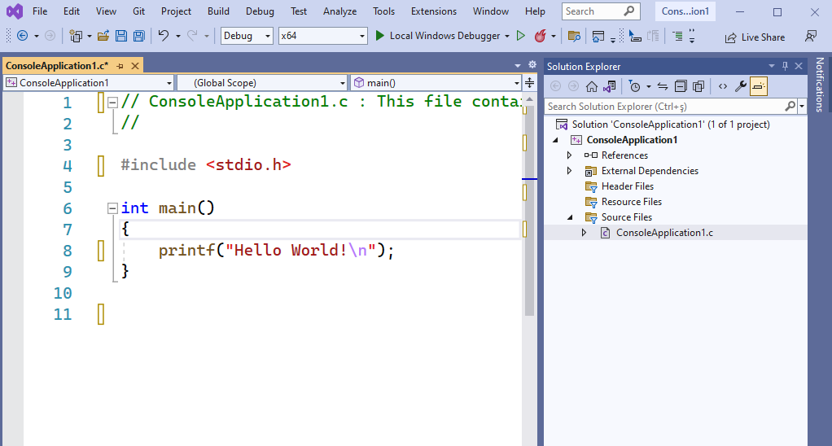
Visual Studio Community Edition (Install / Compile / Run / Debug) (12)
We need to update our source for C as follows
bg right height:350px

Slide 97
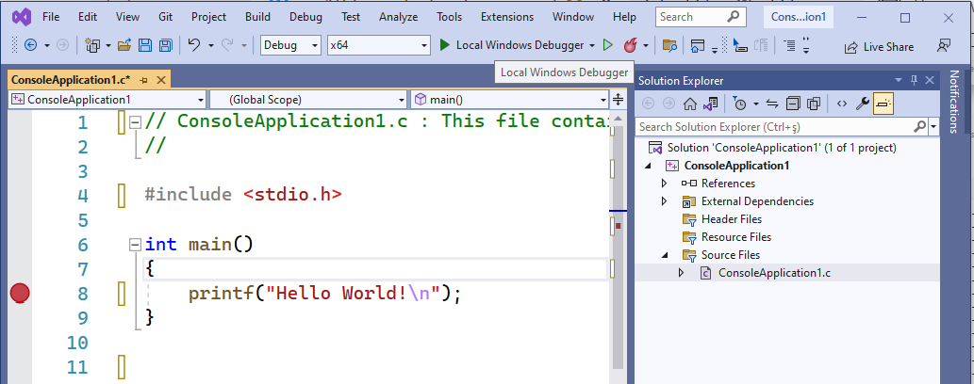
Visual Studio Community Edition (Install / Compile / Run / Debug) (13)
Put a breakpoint by clicking the following location. Breakpoints will be stop points for our debugging operations.
bg right height:350px

Slide 98
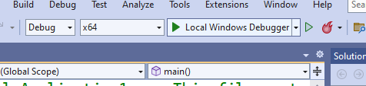
Visual Studio Community Edition (Install / Compile / Run / Debug) (14)
Then select Debug configuration and according to your operating system select x64 or x86 configuration and click Local Windows Debugger
bg right width:650px

Slide 99
Visual Studio Community Edition (Install / Compile / Run / Debug) (15)
Update your source code as follow
// ConsoleApplication1.c : This file contains the 'main' function. Program execution begins and ends there. // #include <stdio.h> int sum(int input1, int input2); int main(){ int number = 5; printf("Before Increment : %d\n",number); number = sum(number, 5); printf("After Increment : %d\n", number); } int sum(int input1, int input2){ return input1 + input2; }

Slide 100
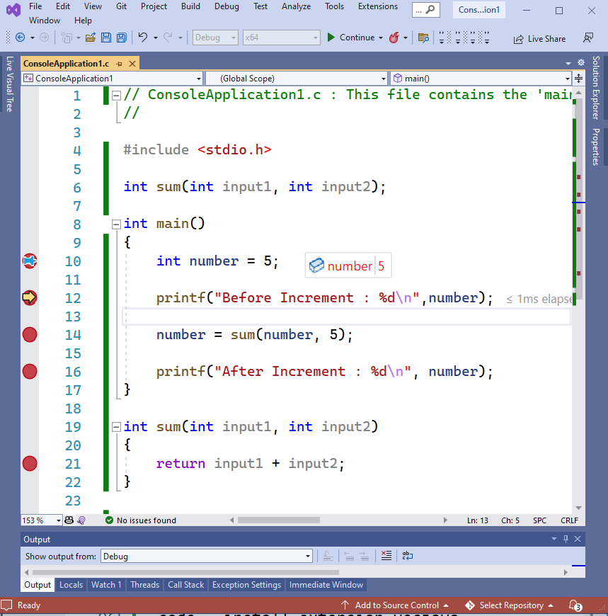
Visual Studio Community Edition (Install / Compile / Run / Debug) (16)
Put the following breakpoints and run the debugger. On number, the variable pins the variable to see its value in real-time.
bg right width:650px

Slide 101
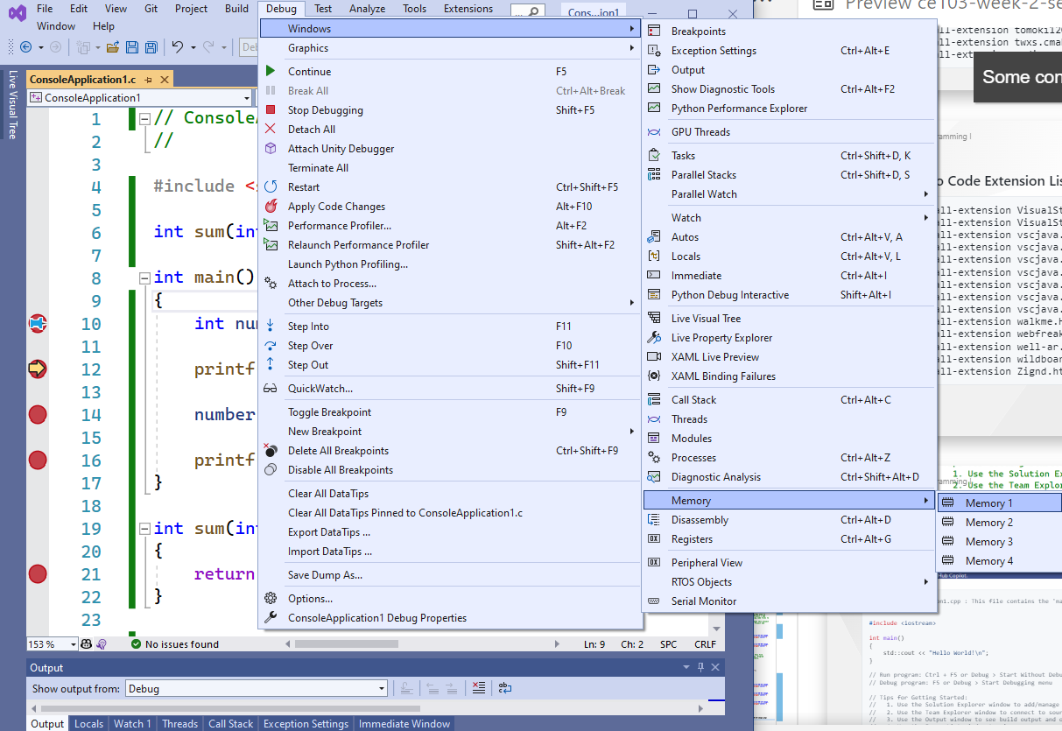
Visual Studio Community Edition (Install / Compile / Run / Debug) (17)
Open Debug->Windows->Memory->Memory1 to see value in memory
bg right width:650px

Slide 102
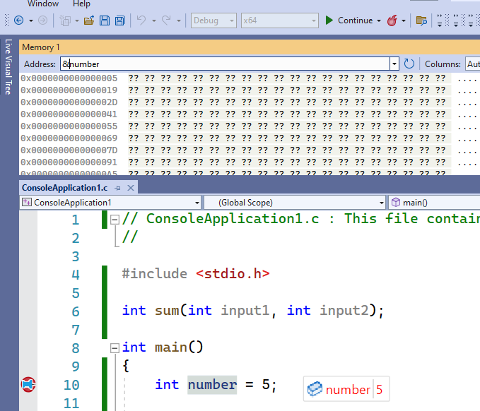
Visual Studio Community Edition (Install / Compile / Run / Debug) (18)
In the memory window copy variable name (number) with address operator (&) and then (&number) press enter.
bg right width:550px

Slide 103
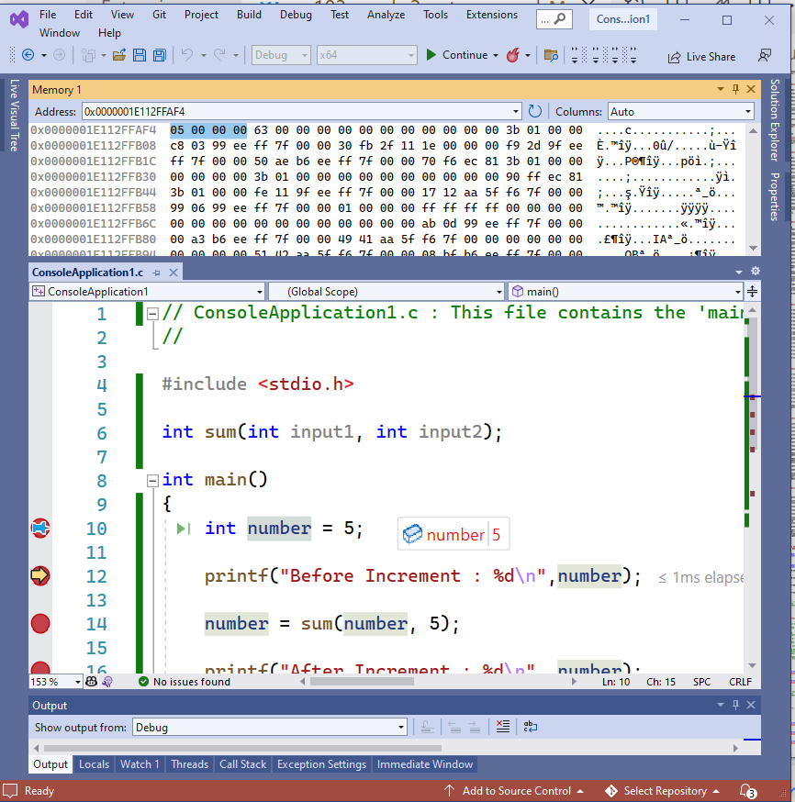
Visual Studio Community Edition (Install / Compile / Run / Debug) (19)
You can see its value in memory with hexadecimal form (05 00 00 00)
bg right width:550px

Slide 104

Visual Studio Community Edition (Install / Compile / Run / Debug) (20)
If you change value with pinned control your memory value and your current value will be updated. 20 in hexadecimal 0x14 (integer is 4 bytes length for this reason memory shows 14 00 00 00)
center height:150px

Slide 105

center height:200px

Slide 106

Visual Studio Community Edition (Install / Compile / Run / Debug) (21)
If you close some windows such as solution explorer, and properties windows you can open them from the View menu.
bg right height:650px

Slide 107

Visual Studio Community Edition (Install / Compile / Run / Debug) (22)
Solution and Projects have several configurations for each setup such as Release - x86, Release-x64, Debug- x86, and Debug-x64 you need to configure all of them for your requirements. You can access configurations by right-clicking to project and then selecting properties.
bg right height:650px

Slide 108

Visual Studio Community Edition (Install / Compile / Run / Debug) (23)
Project properties has several settings
center height:400px

Slide 109
Notepad++ (Install / Compile ) (1)
h:100px

Slide 110
Please download Notepad++ from the following link
Downloads | Notepad++

Slide 111
Notepad++ (Install / Compile ) (2)
Download and install MinGW or LLVM compiler (if you downloded then skip this step)
MinGW installer (gcc / g++)
A complete runtime environment for gcc
https://sourceforge.net/projects/mingw-w64/
https://sourceforge.net/projects/mingw-w64/files/latest/download
w64devkit is a portable C and C++ development kit for x64 (and x86) Windows.
https://www.mingw-w64.org/downloads/#w64devkit
Also, see the following notes
https://www.hanshq.net/building-gcc.html

Slide 112
Notepad++ (Install / Compile ) (3)
LLVM installer (clang)
Download
https://releases.llvm.org/
Also, use the following notes
https://llvm.org/devmtg/2014-04/PDFs/Talks/clang-cl.pdf
https://www.hanshq.net/clang-plugin-example.html

Slide 113
Notepad++ (Install / Compile ) (4)
Open a console with “cmd” and test the following commands if commands are not recognized then set the system environment variable to add gcc and g++ executable paths to the path variable (add to both system and user path variable)
gcc --version g++ --version
C:\Users\ugur.coruh>gcc --version gcc (x86_64-win32-seh-rev0, Built by MinGW-W64 project) 8.1.0 Copyright (C) 2018 Free Software Foundation, Inc. This is free software; see the source for copying conditions. There is NO warranty; not even for MERCHANTABILITY or FITNESS FOR A PARTICULAR PURPOSE.

Slide 114
Notepad++ (Install / Compile ) (5)
Open system environments to update path variable for gcc/g++ and clang
alt:“alt” height:450px center

Slide 115

Notepad++ (Install / Compile ) (6)
Open “Environment Variables”
alt:“alt” height:450px center

Slide 116

Notepad++ (Install / Compile ) (7)
Select path variable from user section.
alt:“alt” height:450px center

Slide 117
Notepad++ (Install / Compile ) (8)
Select path variable from system section. alt:“alt” height:350px center

Slide 118

Notepad++ (Install / Compile ) (9)
Update variables add MinGW and LLVM to path gcc.exe g++.exe clang.exe will be in bin folders. Then we can run this commands from command line.
alt:“alt” height:250px center

Slide 119

Notepad++ (Install / Compile ) (9)
Update variables add MinGW and LLVM to path gcc.exe g++.exe clang.exe will be in bin folders. Then we can run this commands from command line.
alt:“alt” height:250px center

Slide 120
Notepad++ (Install / Compile ) (10)
for gcc.exe, g++.exe and gdb.exe
C:\Program Files\mingw-w64\x86_64-8.1.0-win32-seh-rt_v6-rev0\mingw64\bin

Slide 121
Notepad++ (Install / Compile ) (11)
for clang.exe , lldb.exe we will use the following path
C:\Program Files\LLVM\bin

Slide 122

Notepad++ (Install / Compile ) (12)
This folder paths changes according to your setup
Open NppExec extension (install from extension manager if not exist)
alt:“alt” height:450px center

Slide 123

Notepad++ (Install / Compile ) (13)
Write the following commands in the box
NPP_SAVE // save current file cd $(CURRENT_DIRECTORY) // go to directory of the current file gcc -Wall -Wextra -Wpedantic -std=c++11 -o "$(NAME_PART)" "$(FILE_NAME)"
alt:“alt” height:300px center

Slide 124
Notepad++ (Install / Compile ) (14)
Save the script as gcc-build and for more information check the following link
You can modify or add multiple scripts for another task.

Slide 125
MSYS2
Software Distribution and Building Platform for Windows
https://www.msys2.org/

Slide 126
Vi/Vim (C/C++) for Windows (1)
Vim is a command-line editor for programming
Use the following links to download Vim for Windows
https://github.com/vim/vim-win32-installer/releases
download : vim online

Slide 127

Vi/Vim (C/C++) for Windows (2)
Run setup to install the application on your computer.
alt:“alt” height:100px center

Slide 128

Vi/Vim (C/C++) for Windows (3)
alt:“alt” height:350px center

Slide 129

Vi/Vim (C/C++) for Windows (4)
Installation steps.
alt:“alt” height:350px center

Slide 130

Vi/Vim (C/C++) for Windows (5)
Installation steps.
alt:“alt” height:350px center

Slide 131

Vi/Vim (C/C++) for Windows (6)
Installation steps.
alt:“alt” height:350px center

Slide 132

Vi/Vim (C/C++) for Windows (7)
Installation steps.
alt:“alt” height:350px center

Slide 133

Vi/Vim (C/C++) for Windows (8)
Installation steps.
alt:“alt” height:350px center

Slide 134

Vi/Vim (C/C++) for Windows (9)
Installation steps.
alt:“alt” height:350px center

Slide 135

Vi/Vim (C/C++) for Windows (10)
Generated shortcuts on your desktop
alt:“alt” height:350px center

Slide 136

Vi/Vim (C/C++) for Windows (11)
Run vim hello.c on your command-line to open a c file with vim editor.
bg right height:550px center

Slide 137

Vi/Vim (C/C++) for Windows (12)
You will have the following editor.
Use INSERT to change edit options.
alt:“alt” height:450px center

Slide 138
Vi/Vim (C/C++) for Windows (13)
Sample source code
#include <stdio.h> int main() { char name[20]; printf("Enter Name:"); scanf("%s",name); printf("Your name is %s",name); return 0; }

Slide 139

Vi/Vim (C/C++) for Windows (14)
Write source code
Press the Esc button to enter command mode
Then type :wq. It will save the file and exit from Vim
w: write
q: quit
alt:“alt” height:300px center

Slide 140

Vi/Vim (C/C++) for Windows (15)
compile source code with gcc
link the objects and
run executable
alt:“alt” height:300px center

Slide 141

Vi/Vim (C/C++) for Windows (17)
In the folder, you can find your executable. hello.exe
alt:“alt” height:400px center

Slide 142

Vi/Vim (C/C++) for Windows (16)
compile, link and execute flow will be as follow;
bg right height:650px center

Slide 143

Eclipse (C/C++) - Compile Only / Debugging Has Problem (1)
Download and install Eclipse IDE from the following link
Eclipse IDE for C/C++ Developers | Eclipse Packages
Run Installer
Select Eclipse IDE for C/C++ Developers
alt:“alt” height:450px center

Slide 144

Eclipse (C/C++) - Compile Only / Debugging Has Problem (2)
Select Java Version and Installation Path
alt:“alt” height:450px center

Slide 145

Eclipse (C/C++) - Compile Only / Debugging Has Problem (3)
After installation you can LAUNCH eclipse IDE
alt:“alt” height:450px center

Slide 146

Eclipse (C/C++) - Compile Only / Debugging Has Problem (4)
alt:“alt” height:450px center

Slide 147

Eclipse (C/C++) - Compile Only / Debugging Has Problem (5)
Select a workspace that your project will be saved
alt:“alt” height:450px center

Slide 148

Eclipse (C/C++) - Compile Only / Debugging Has Problem (6)
You can find your installation under your user folder
alt:“alt” height:450px center

Slide 149

Eclipse (C/C++) - Compile Only / Debugging Has Problem (7)
You can create shortcut to desktop for your working eclipse version.
alt:“alt” height:450px center

Slide 150

Eclipse (C/C++) - Compile Only / Debugging Has Problem (8)
File -> New -> Project
alt:“alt” height:450px center

Slide 151

Eclipse (C/C++) - Compile Only / Debugging Has Problem (9)
Select C/C++ Project
alt:“alt” height:450px center

Slide 152

Eclipse (C/C++) - Compile Only / Debugging Has Problem (10)
Select C Managed Build, Eclipse CDT will do job for us.
alt:“alt” height:450px center

Slide 153

Eclipse (C/C++) - Compile Only / Debugging Has Problem (11)
Give project name and select a basic template executable with MinGW GCC.
alt:“alt” height:450px center

Slide 154

Eclipse (C/C++) - Compile Only / Debugging Has Problem (12)
Configura Basic Settings
alt:“alt” height:450px center

Slide 155

Eclipse (C/C++) - Compile Only / Debugging Has Problem (13)
There are default Debug and Release configurations you can add your customized configurations from Advanced Settings.
alt:“alt” height:450px center

Slide 156

Eclipse (C/C++) - Compile Only / Debugging Has Problem (14)
Project settings will be C Select Debug/Release configuration and then Build Application Project->Build All (Ctrl+B)
HelloWorldC.exe will be generated
gcc -O0 -g3 -Wall -c -fmessage-length=0 -o "src\\HelloWorldC.o" "..\\src\\HelloWorldC.c" gcc -o HelloWorldC.exe "src\\HelloWorldC.o"
alt:“alt” height:450px center

Slide 157

Eclipse (C/C++) - Compile Only / Debugging Has Problem (15)
Before build if you want to debug application select debug configuration, put your breakpoints and then Build application again.
Right click the generated executable Debug As -> Local C/C++ Application
alt:“alt” height:450px center

Slide 158

Eclipse (C/C++) - Compile Only / Debugging Has Problem (16)
Debugger will start and stop at breakpoint as follow.
alt:“alt” height:450px center

Slide 159

Eclipse (C/C++) - Compile Only / Debugging Has Problem (16)
Check debug control shortcuts and use them
alt:“alt” height:250px center

Slide 160

Eclipse (C/C++) - Compile Only / Debugging Has Problem (17)
To watch variables use Expressions and Variables
alt:“alt” height:450px center

Slide 161

Eclipse (C/C++) - Compile Only / Debugging Has Problem (18)
alt:“alt” height:450px center

Slide 162
Eclipse (C/C++) - Compile Only / Debugging Has Problem (19)
for more visit eclipse webpage
Effective Techniques for Debugging C & C++ | The Eclipse Foundation
Help - Eclipse IDE

Slide 163

Eclipse (C/C++) - Compile Only / Debugging Has Problem (20)
Generate CMAKE project from new Project and Select CMake Project Template
alt:“alt” height:450px center

Slide 164

Eclipse (C/C++) - Compile Only / Debugging Has Problem (21)
Give project name
alt:“alt” height:450px center

Slide 165

Eclipse (C/C++) - Compile Only / Debugging Has Problem (22)
This will generate default C++ Hello World project
alt:“alt” height:450px center

Slide 166

Eclipse (C/C++) - Compile Only / Debugging Has Problem (23)
Build Project
alt:“alt” height:450px center

Slide 167
Eclipse (C/C++) - Compile Only / Debugging Has Problem (24)
It will give following errors, for missing configurations. This errors are generated by CMAKE
Then clean and rebuild again.
Errors occurred during the build. Errors running builder 'CDT Core Builder' on project 'HelloWorldCmakeC'. Resource '/HelloWorldCmakeC/build/cmake.debug.win32.x86_64/compile_commands.json' does not exist. Resource '/HelloWorldCmakeC/build/cmake.debug.win32.x86_64/compile_commands.json' does not exist. Resource '/HelloWorldCmakeC/build/cmake.debug.win32.x86_64/compile_commands.json' does not exist. Resource '/HelloWorldCmakeC/build/cmake.debug.win32.x86_64/compile_commands.json' does not exist.

Slide 168

Eclipse (C/C++) - Compile Only / Debugging Has Problem (25)
alt:“alt” height:450px center

Slide 169

Eclipse (C/C++) - Compile Only / Debugging Has Problem (26)
After this operation first Clean project from Project menu and then Build All again
alt:“alt” height:450px center

Slide 170
Eclipse (C/C++) - Compile Only / Debugging Has Problem (27)
Eclipse with CMake project on windows
JV - Science and stuff.

Slide 171

Eclipse (C/C++) - Compile Only / Debugging Has Problem (28)
alt:“alt” height:450px center

Slide 172

Eclipse (C/C++) - Compile Only / Debugging Has Problem (29)
alt:“alt” height:450px center

Slide 173

Netbeans (C/C++) - Manuel Build/Clean/Run Command Setting Not Good Option for C/C++ Development (1)
https://netbeans.apache.org/
C and C++ Tutorials
alt:“alt” height:250px center

Slide 174

Netbeans (C/C++) - Manuel Build/Clean/Run Command Setting Not Good Option for C/C++ Development (2)
alt:“alt” height:450px center

Slide 175

Netbeans (C/C++) - Manuel Build/Clean/Run Command Setting Not Good Option for C/C++ Development (3)
alt:“alt” height:450px center

Slide 176

Netbeans (C/C++) - Manuel Build/Clean/Run Command Setting Not Good Option for C/C++ Development (4)
alt:“alt” height:250px center

Slide 177

Netbeans (C/C++) - Manuel Build/Clean/Run Command Setting Not Good Option for C/C++ Development (5)
alt:“alt” height:450px center

Slide 178

Netbeans (C/C++) - Manuel Build/Clean/Run Command Setting Not Good Option for C/C++ Development (6)
alt:“alt” height:450px center

Slide 179

Netbeans (C/C++) - Manuel Build/Clean/Run Command Setting Not Good Option for C/C++ Development (7)
bg right height:550px center

Slide 180

Netbeans (C/C++) - Manuel Build/Clean/Run Command Setting Not Good Option for C/C++ Development (8)
bg right height:550px center

Slide 181

Turbo C/C++ (1)
Download Turbo.C.3.2.zip
Download Turbo C++ for Windows 7, 8, 8.1, 10 and Windows 11 (32-64 bit) with full/window screen mode and many more extra features
Turbo C++ Shortcuts - C Programming Language Tutorials
bg right height:550px center

Slide 182

Turbo C/C++ (2)
bg right height:550px center

Slide 183
Cmake (C++/C) (1)
CMake (http://www.cmake.org/) is a program which generates the Makefiles used by Make.

Slide 184
Cmake (C++/C) (2)
Why use CMake ?
Eases Make use
but the same way of thinking
generate the Makefile
Separate the compilation from the sources
Multi-platfoms
Very flexible

Slide 185
Cmake (C++/C) (3)
Check if the libraries/programs are available on your system
File generator (configure_file)
Calling programs or scripts (doxygen)
One of the new standards

Slide 186
Cmake (C++/C) (4) (Download and Install)
use the following link for download
Download | CMake

Slide 187
Cmake (C++/C) (5) (WSL and Linux Environment)
Hello world with CMake

Slide 188
Cmake (C++/C) (6) (Windows Environment)
main.c
#include <stdio.h> int main() { char name[20]; printf("Enter name: "); scanf("%s", name); printf("Your name is %s.", name); return 0; }
CMakeLists.txt
cmake_minimum_required(VERSION 3.7.2) project(scanf-sample) add_executable(scanf-sample main.c)

Slide 189

Cmake (C++/C) (7) (Windows Environment)
put main.c and CMakeLists.txt file in sample-scanf folder and from command line
alt:“alt” height:450px center

Slide 190
run the following cmake command with dot (.) to create solution file for c project
C:\Users\ugur.coruh\Desktop\sample-scanf>cmake .

Slide 191
Cmake (C++/C) (8) (Windows Environment)
I have Visual Studio 2022 Community Edition Installed on My Computer, for these reason build tools are selected for visual studio environment and the following outputs are generated
C:\Users\ugur.coruh\Desktop\sample-scanf>cmake . -- Building for: Visual Studio 17 2022 -- Selecting Windows SDK version 10.0.22000.0 to target Windows 10.0.19043. -- The C compiler identification is MSVC 19.30.30704.0 -- The CXX compiler identification is MSVC 19.30.30704.0 -- Detecting C compiler ABI info -- Detecting C compiler ABI info - done -- Check for working C compiler: C:/Program Files/Microsoft Visual Studio/2022/Community/VC/Tools/MSVC/14.30.30704/bin/Hostx64/x64/cl.exe - skipped -- Detecting C compile features -- Detecting C compile features - done -- Detecting CXX compiler ABI info -- Detecting CXX compiler ABI info - done -- Check for working CXX compiler: C:/Program Files/Microsoft Visual Studio/2022/Community/VC/Tools/MSVC/14.30.30704/bin/Hostx64/x64/cl.exe - skipped -- Detecting CXX compile features -- Detecting CXX compile features - done -- Configuring done -- Generating done -- Build files have been written to: C:/Users/ugur.coruh/Desktop/sample-scanf C:\Users\ugur.coruh\Desktop\sample-scanf>

Slide 192

Cmake (C++/C) (9) (Windows Environment)
also following files are generated
alt:“alt” height:450px center

Slide 193

Cmake (C++/C) (10) (Windows Environment)
if we open scanf-sample.sln file we will have automated generated project files
alt:“alt” height:450px center

Slide 194

Cmake (C++/C) (11) (Windows Environment)
you can make scanf-sample with startup project with right click and then run on visual studio.
if you want to configure for another build tool you can use Cmake-GUI installed with setup on your computer
alt:“alt” height:150px center

Slide 195

Cmake (C++/C) (12) (Windows Environment)
Open GUI and Select File-> Delete Cache
alt:“alt” height:450px center

Slide 196

Cmake (C++/C) (13) (Windows Environment)
then you can click “Configure” to select build tool
alt:“alt” height:450px center

Slide 197

Cmake (C++/C) (14) (Windows Environment)
alt:“alt” height:400px center

Slide 198
Cmake (C++/C) (15) (Windows Environment)
if you click “Configure” twice it will generate the visual studio solution in build folder
for more detailed examples that include also docker and travis-ci sample you can check the following repo
GitHub - ttroy50/cmake-examples: Useful CMake Examples

Slide 199
Make (1)
Sample
hello.c
#include <stdio.h> int main(void) { printf("hello, world\n"); }

Slide 200
Make (2)
Makefile
# This is the default target, which will be built when # you invoke make .PHONY: all all: hello # This rule tells make how to build hello from hello.cpp hello: hello.c g++ -o hello hello.c # This rule tells make to copy hello to the binaries subdirectory, # creating it if necessary .PHONY: install install: mkdir -p binaries cp -p hello binaries # This rule tells make to delete hello and hello.o .PHONY: clean clean: rm -f hello

Slide 201
Make (3)
compile.bat
make all .
will create hello.exe
check hello-make sample

Slide 202

Make (4)
alt:“alt” height:450px center

Slide 203

JAVA Environment and Development
alt:“alt” height:450px center

Slide 204

JDK and JRE Setup (1)
alt:“alt” height:450px center

Slide 205
JDK and JRE Setup (2)
JDK (Java Development Kit) is a Kit that provides the environment to develop and execute(run) the Java program. JDK is a kit(or package) that includes two things
Development Tools(to provide an environment to develop your java programs)
JRE (to execute your java program).
JRE (Java Runtime Environment) is an installation package that provides an environment to only run(not develop) the java program(or application)onto your machine. JRE is only used by those who only want to run Java programs that are end-users of your system.
JVM (Java Virtual Machine) is a very important part of both JDK and JRE because it is contained or inbuilt in both. Whatever Java program you run using JRE or JDK goes into JVM and JVM is responsible for executing the java program line by line, hence it is also known as an i***nterpreter***.

Slide 206

Difference between JDK, JRE, JVM - TutorialAndExample
alt:“alt” height:450px center

Slide 207

System Environments and Paths for Java (1)
alt:“alt” height:450px center

Slide 208

System Environments and Paths for Java (2)
Select path variable (JDK should be set there)
alt:“alt” height:450px center

Slide 209

System Environments and Paths for Java (3)
JAVA_HOME also should be set
alt:“alt” height:450px center

Slide 210

Netbeans (Java) (1)
Open New Project -> Java Project
alt:“alt” height:450px center

Slide 211

Netbeans (Java) (2)
alt:“alt” height:450px center

Slide 212

Netbeans (Java) (3)
alt:“alt” height:450px center

Slide 213

Netbeans (Java) (4)
alt:“alt” height:450px center

Slide 214

Netbeans (Java) (5)
alt:“alt” height:450px center

Slide 215

Netbeans (Java) (6)
Update code and run
alt:“alt” height:100px center

Slide 216
/* * Click nbfs://nbhost/SystemFileSystem/Templates/Licenses/license-default.txt to change this license * Click nbfs://nbhost/SystemFileSystem/Templates/Classes/Class.java to edit this template */ package com.ucoruh.mavenproject1; /** * * @author ugur.coruh */ public class NewClass { static //static block { System.out.println("Static block"); } public static void main(String args[]) //static method { System.out.println("Static method"); } }

Slide 217

Netbeans (Java) (7)
alt:“alt” height:450px center

Slide 218

Netbeans (Java) (8)
alt:“alt” height:450px center

Slide 219

Netbeans (Java) (9)
alt:“alt” height:450px center

Slide 220

Netbeans (Java) (10)
alt:“alt” height:450px center

Slide 221

Eclipse (Java) (1)
Select File -> New Project
alt:“alt” height:450px center

Slide 222

Eclipse (Java) (2)
alt:“alt” height:450px center

Slide 223

Eclipse (Java) (3)
alt:“alt” height:450px center

Slide 224

Eclipse (Java) (4)
alt:“alt” height:450px center

Slide 225

Eclipse (Java) (5)
alt:“alt” height:450px center

Slide 226
Eclipse (Java) (6)
Update source
package ucoruh; public class HelloClass { static { System.out.println("Static Block"); } public static void main(String[] args) { // TODO Auto-generated method stub System.out.println("Static Method"); } }

Slide 227

Eclipse (Java) (7)
alt:“alt” height:450px center

Slide 228

Eclipse (Java) (8)
alt:“alt” height:450px center

Slide 229

Intellij Idea (Jet Brains) (Java)
Download IntelliJ IDEA: The Capable & Ergonomic Java IDE by JetBrains
Select Community Version or Student Ultimate Version
alt:“alt” height:450px center

Slide 230

VSCode (Java)
Java Extension Run&Debug Java Files
alt:“alt” height:450px center

Slide 231
Notepad++ (Java)
How to Compile and Run Java Programs Using Notepad++

Slide 232
Cmake (Java)
UseJava — CMake 3.24.2 Documentation
GitHub - ptitpoulpe/cmake-swig-java-example: An example of combining cmake, swig and java

Slide 233
C# Environment and Development

Slide 234

Visual Studio Community Edition (C#)
//TODO//
alt:“alt” height:200px center

Slide 235
Notepad++ (C#)
This use command-line utilities for csharp, nppexec should be configured for this utility.
Compiling/Executing a C# Source File in Command Prompt - Stack Overflow
c:\windows\Microsoft.NET\Framework\v3.5\
c:\windows\Microsoft.NET\Framework\v3.5\bin\csc.exe /t:exe /out:MyApplication.exe MyApplication.cs ...

Slide 236
Cmake (C#)
GitHub - crud89/DotNetWithCMake: Your swiss army knife for creating .NET assemblies with CMake and integrating unmanaged code.

Slide 237
Common Tools and Platforms

Slide 238

Fatih Kalem
height:150px

Slide 239

https://cdnvideo.eba.gov.tr/fatihkalem/fatihkalem_portable.zip
https://cdnvideo.eba.gov.tr/fatihkalem/fatihkalem_setup.exe
bg right height:350px

Slide 240

Notepad++ (Notepad for Source Code)
Downloads | Notepad++
bg right height:450px

Slide 241

HxD (Hex Editor)
height:100px

Slide 242

HxD - Freeware Hex Editor and Disk Editor | mh-nexus
bg right height:450px

Slide 243

Marktext (Markdown Syntax Editor)
height:100px

Slide 244

https://marktext.app/
https://github.com/marktext/marktext/releases
Download latest version
https://github.com/marktext/marktext/releases/tag/v0.17.1
bg right height:450px

Slide 245

Cygwin (Linux environment for Windows)
height:100px

Slide 246

https://www.cygwin.com/
bg right height:450px

Slide 247

Dependency Walker (32-bit or 64-bit Windows module dependency checker)
height:100px

Slide 248

https://www.dependencywalker.com/
bg right height:450px

Slide 249

Doxygen (Code Documentation)
height:100px

Slide 250

Doxygen: Doxygen
bg right height:450px

Slide 251

Sonarlint (Code Quality and Code Security Extension)
height:100px

Slide 252
https://www.sonarlint.org/

Slide 253

Codepen.io (online code sharing)
height:100px

Slide 254

https://codepen.io/
CodePen is a social development environment. At its heart, it allows you to write code in the browser, and see the results of it as you build.
A useful and liberating online code editor for developers of any skill, and particularly empowering for people learning to code. We focus primarily on front-end languages like HTML, CSS, JavaScript, and preprocessing syntaxes that turn into those things
bg right height:450px

Slide 255
Codepen.io (online code sharing)
Credit Card Sample on Codepen
https://codepen.io/quinlo/pen/YONMEa
Checkout trends https://codepen.io/trending

Slide 256

Codeshare.io (real-time code sharing)
height:100px

Slide 257

https://codeshare.io/
Share Code in Real-time with Developers, An online code editor for interviews, troubleshooting, teaching & more…
bg right height:450px

Slide 258

Codebeautify.org (online data conversion tools)
height:100px

Slide 259
Has several tools for developers (Code Formatter, JSON Beautifier, XML Viewer, Hex Converters and more…)
https://codebeautify.org/

Slide 260

AsciiFlow.com (ASCII drawing tool)
Asciflow provides ascii based drawings that you can copy directly to textfiles and source codes. Visit the following link
https://asciiflow.com/

Slide 261

Freemind (opensource mindmap application)
Freemind is open source java based desktop mindmap application. Can export files to several formats
Main Page - FreeMind
alt:“alt” height:250px center

Slide 262
Mockup Designers
Mockflow
Signup - MockFlow
Wireflow
https://wireflow.co/

Slide 263
PlantUML (software designer)
Text based designer for software engineers
https://plantuml.com/
PlantUML Web Server
Also visit course notes that related to plantuml CE204 Object-Oriented Programming - RTEU C204 Object Oriented Programming Course Notes

Slide 264

Drawio (drawing tool)
Online and Offline Drawing Tool
https://app.diagrams.net/
Offline Installer
Releases · jgraph/drawio-desktop · GitHub
alt:“alt” height:350px center

Slide 265

Putty (Remote Connection)
Commonly use for SSH connection
alt:“alt” height:450px center

Slide 266

We can run a SSH server with MobaXterm and can connect to same computer with Putty.
alt:“alt” height:450px center

Slide 267

alt:“alt” height:450px center

Slide 268

alt:“alt” height:450px center

Slide 269
Download file over SSH Protocol
How to Download and Upload Files over SSH – TecAdmin
Here are some useful examples for downloading files from the remote system over SSH protocol.
This will connect to example.com server with user “username” and copy the /backup/file.zip file to local system directory /local/dir. To use theis command replace the values as per your environment.
scp username@example.com:/backup/file.zip /local/dir
If the SSH is running on a non-standard port, You can specify the port using -P option with SCP command.
scp -P 2222 username@example.com:/backup/file.zip /local/dir
If your remote server required a private key to connect server, You can use -i followed by a private key file path to connect your server using the SCP command. This can be helpful for AWS servers.
scp -i private_key.pem username@example.com:/backup/file.zip /local/dir

Slide 270
Upload file using SSH
You can also upload files to the remote server using SSH protocol using the SCP command. Use the following example command for uploading files to the SSH server.
scp file.zip username@example.com:/remote/dir
Similarity you can use -P switch to define port of the SSH server and -i to define private key for the user authentication.

Slide 271
Also you can use SSH tunnels for remote code development
Developing on Remote Machines using SSH and Visual Studio Code
Visual Studio Code Server

Slide 272

MobaXterm (Remote Connection)
Multip Purpose Remote Connection Toolkit
alt:“alt” height:450px center

Slide 273

alt:“alt” height:450px center

Slide 274

alt:“alt” height:450px center

Slide 275

Teamviewer (Remote Connection)
Remote connection tool
TeamViewer – Uzaktan Destek, Uzaktan Erişim, Hizmet Masası, Çevrimiçi İşbirliği ve Toplantılar

Slide 276

AnyDesk
Remote connection tool
The Fast Remote Desktop Application – AnyDesk
alt:“alt” height:450px center

Slide 277

Paletton.com and Colorhunt.co (Color Chooser)
Generates color pallettes and sample usages
Paletton - The Color Scheme Designer
https://colorhunt.co/
Also check Colors Tutorial
alt:“alt” height:450px center

Slide 278

alt:“alt” height:450px center

Slide 279

Understand (Static Code Analysis)
https://emenda.com/scitools-understand/
alt:“alt” height:450px center

Slide 280

alt:“alt” height:450px center

Slide 281

JD Project (Java Decompiler)
Java Decompiler for Jar and Class Files, If code is not obfuscated it recover source code from compiled files. Just drag and drop files to GUI
http://java-decompiler.github.io/
You can use it standalone app or with eclipse
alt:“alt” height:450px center

Slide 282

Cutter (Multi-Platform Reverse Engineering Tool)
Cutter’s goal is to be an advanced FREE and open-source reverse-engineering platform while keeping the user experience at mind. Cutter is created by reverse engineers for reverse engineers.
https://cutter.re/
alt:“alt” height:450px center

Slide 283
IDA Pro / Freeware (Native Reverse Engineering Tool)
IDA Pro as a disassembler is capable of creating maps of their execution to show the binary instructions that are actually executed by the processor in a symbolic representation (assembly language). Advanced techniques have been implemented into IDA Pro so that it can generate assembly language source code from machine-executable code and make this complex code more human-readable.

Slide 284

IDA Pro / Freeware (Native Reverse Engineering Tool)
Hex Rays - State-of-the-art binary code analysis solutions
alt:“alt” height:450px center

Slide 285

IDA Pro / Freeware (Native Reverse Engineering Tool)
alt:“alt” height:450px center

Slide 286

Code Visualization (Python, C , C++ , Java)
This coding tutor tool helps you learn Python, JavaScript, C, C++, and Java by visualizing code execution.
https://pythontutor.com/
alt:“alt” height:450px center

Slide 287

Assembly of C Code
Multilanguage supported. Convert source code to assembly codes
https://godbolt.org/
alt:“alt” height:450px center

Slide 288
Mobile Device Screen Sharing for Demo
Show USB or Wifi connected Mobile Device Screen on PC and Provide Controls
GitHub - Genymobile/scrcpy: Display and control your Android device
Run scrcpy for single mobile phone.
Open Source Project - Scrcpy now works wirelessly

Slide 289
Travis-CI
Travis-CI is a continues integration platform
Travis-CI free option removed for this reason, its not in our scope.
It uses Travis.yml files for actions.

Slide 290
AppVeyor
Another CI platform it has free option for public builds.
https://www.appveyor.com
GitHub - Kimserey/hello-world-nuget
hello-world-nuget/appveyor.yml at master · Kimserey/hello-world-nuget · GitHub

Slide 291

Jenkins
Self-hosted solution for CI operations, Has integration with Github and several platforms.
https://www.jenkins.io/
https://www.jenkins.io/doc/pipeline/tour/hello-world/
alt:“alt” height:350px center

Slide 292

Jenkins
alt:“alt” height:450px center

Slide 293

Jenkins
https://www.jenkins.io/solutions/github/
bg right height:650px center

Slide 294
Vagrant
Vagrant is a tool for building and managing virtual machine environments in a single workflow. With an easy-to-use workflow and focus on automation, Vagrant lowers development environment setup time, increases production parity, and makes the “works on my machine” excuse a relic of the past.
https://www.vagrantup.com/
Setup Development Environment with Vagrant
Setting Up Development Environment Using Vagrant - Edureka
development-environment/Vagrantfile at master · gantsign/development-environment · GitHub

Slide 295
Docker / Docker Compose / Kubernetes (1)
Docker takes away repetitive, mundane configuration tasks and is used throughout the development lifecycle for fast, easy and portable application development – desktop and cloud.
https://www.youtube.com/watch?v=nBwJm0onzeo&ab_channel=GaryExplains Dockerfile
https://devopedia.org/docker
DockerHub
Docker Compose Yaml
Dockerrun.aws.json (AWS)

Slide 296

Docker / Docker Compose / Kubernetes (2)
alt:“alt” height:450px center

Slide 297

Docker / Docker Compose / Kubernetes (3)
alt:“alt” height:450px center

Slide 298

Docker / Docker Compose / Kubernetes (4)
alt:“alt” height:450px center

Slide 299

Docker / Docker Compose / Kubernetes (5)
alt:“alt” height:450px center

Slide 300

Docker / Docker Compose / Kubernetes (6)
alt:“alt” height:450px center

Slide 301

Nuget Packages (1)
https://www.nuget.org/packages
What is NuGet and what does it do? | Microsoft Learn
alt:“alt” height:450px center

Slide 302

NuGet Tools (2)
alt:“alt” height:450px center

Slide 303

Managing dependencies (3)
alt:“alt” height:450px center

Slide 304

Tracking references and restoring packages (4)
alt:“alt” height:450px center

Slide 305

SCV Cryptomanager
SCV Crypto Manager has several tools for cryptographic operations.
https://cryptomanager.com/download.php
alt:“alt” height:450px center

Slide 306

Addario CryptoBench
CryptoBench can be used for hash and symmetric asymmetric encryption-decryption operations.
CryptoBench Download Page
http://www.addario.org/files/CryptoBench%20v1.0.1.zip
alt:“alt” height:450px center

Slide 307

Raymond’s MD5 & SHA Checksum Utility
Hash Calculation Utility
MD5 & SHA Checksum Utility | Raymond’s WordPress
alt:“alt” height:450px center

Slide 308

SlavaSoft HashCalc
SlavaSoft HashCalc - Hash, CRC, and HMAC Calculator
alt:“alt” height:450px center

Slide 309

Portable PGP
Portable PGP uses for the generation of PGP keys to transfer files securely via e-mail or other channels. You can encrypt or sign your documents with this tool then the receiver can open or verify your e-mail.
https://ppgp.sourceforge.net/
alt:“alt” height:450px center

Slide 310
Online Programming Envoriments
Hackerrank
https://www.hackerrank.com/
CS50 Sandbox
https://sandbox.cs50.io/
Programiz C Online Complier
Online C Compiler

Slide 311
$$End−Of−Week−2$$

